Slide 1

Part 77 vs. Part 157

Slide 2

14 CFR Part 77 Overview
§ 77.1 Purpose.
This part establishes:
(a) The requirements to provide notice to the FAA of certain proposed construction, or the alteration of existing structures;
(b) The standards used to determine obstructions to air navigation, and navigational and communication facilities;
(c) The process for aeronautical studies of obstructions to air navigation or navigational facilities to determine the effect on the safe and efficient use of navigable airspace, air navigation facilities or equipment;

Slide 3
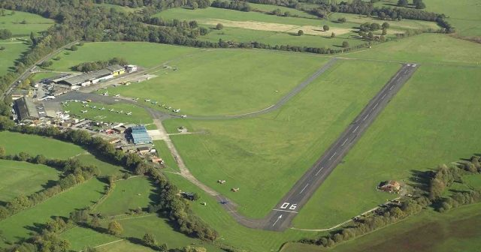
14 CFR Part 157
This part applies to persons proposing to construct, alter, activate, or deactivate a civil or joint-use (civil/military) airport or to alter the status or use of such an airport. Requirements for persons to notify the Administrator concerning certain airport activities are prescribed in this part.

Slide 4

Part 157 Video
Notes:
Objective: “Describe the purpose of Part 157”

Slide 5

Circumstances When Notice is Not Required
Airports maintaining a current approved Airport Layout Plan (ALP) on file with the FAA
Temporary VFR use of an airport that is used fewer than 30 days with 10 or fewer operations per day
Intermittent VFR use of a site that is used one year
or less and:
  Not an established airport
  Used no more than 3 days per week
  Used for fewer than 10 operations per day
Notes:
Objective: “Determine whether a person or entity is required under Part 157 to file notice with the FAA”
Check frequency of flights.

Slide 6
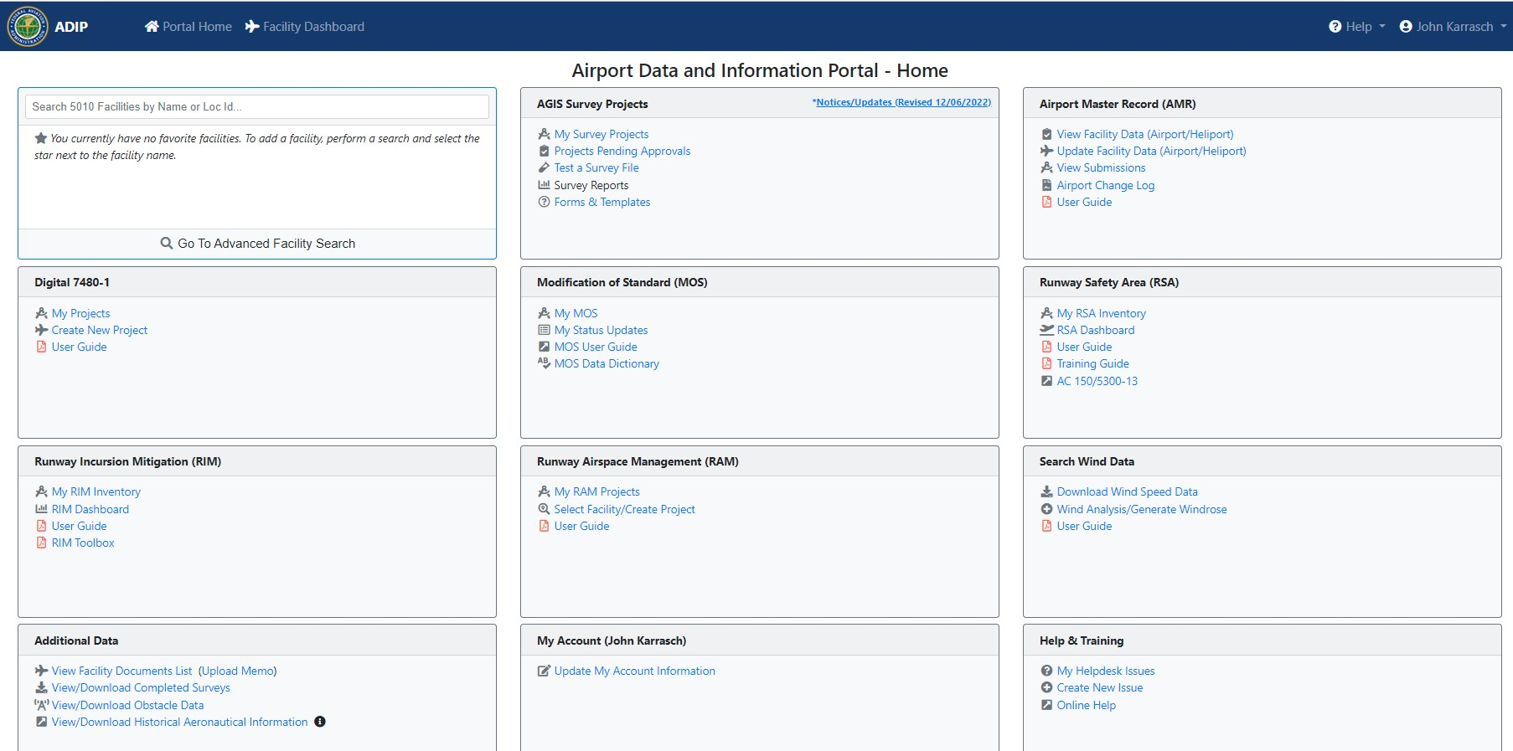
Providing Notice to the FAA
Airport Data and Information Portal (ADIP)-preferred method of notice
Notes:
Objective: “Summarize the process for filing notice with the FAA under Part 157”

Slide 7
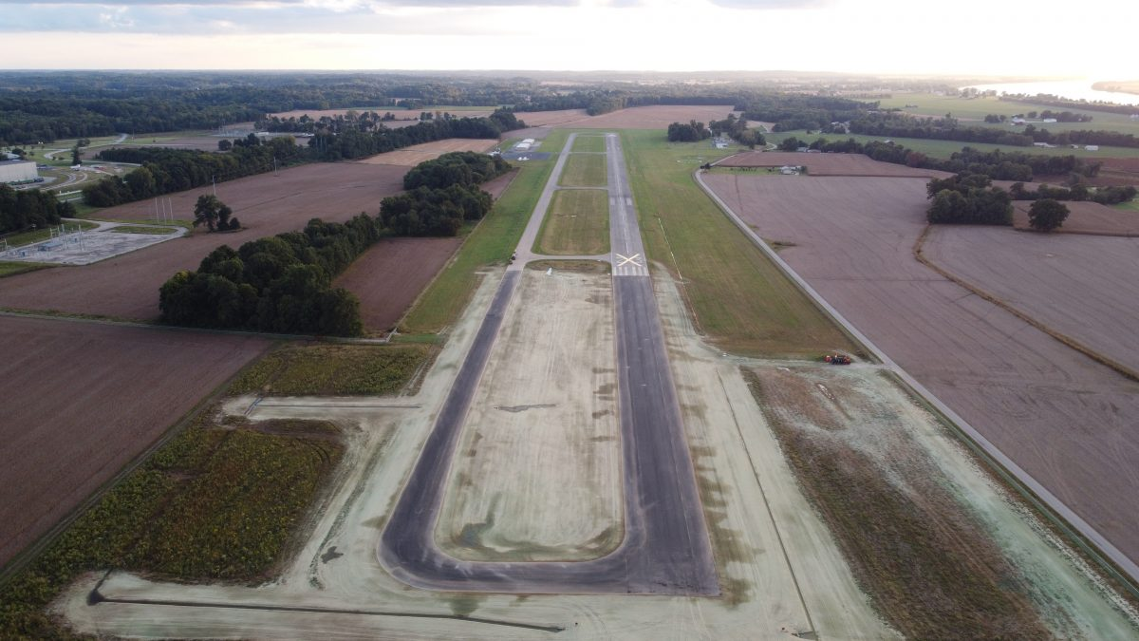
Proposals Subject to Notification
Construct, realign, alter, or activate any runway or
other aircraft landing or takeoff area of an airport.

Slide 8
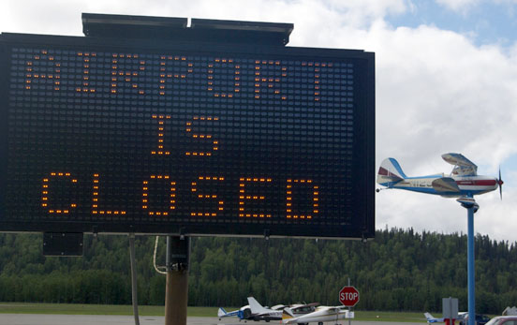
Proposals Subject to Notification
Deactivate, discontinue using, or abandon an airport or
any landing or takeoff area of an airport for a period of one year or more.

Slide 9
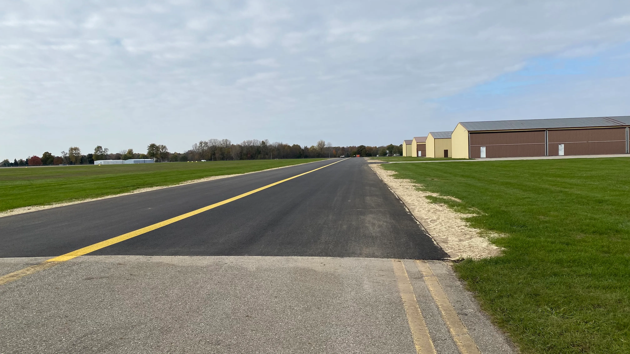
Proposals Subject to Notification
Construct, realign, alter, activate, deactivate, abandon, or discontinue using a taxiway associated with a landing or takeoff area on a public-use airport.

Slide 10
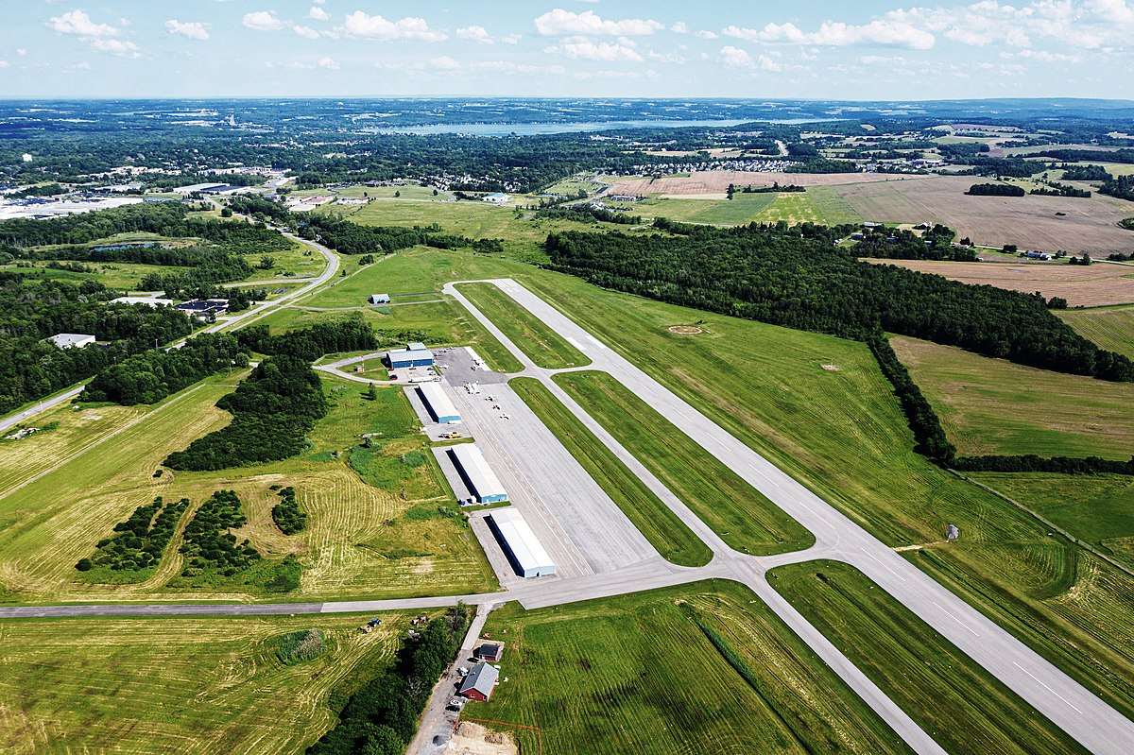

Proposals Subject to Notification
Change the status of an airport from private use to public use
or from public use to another status.

Slide 11
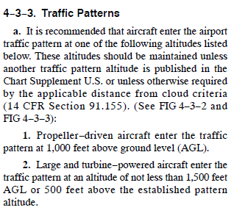
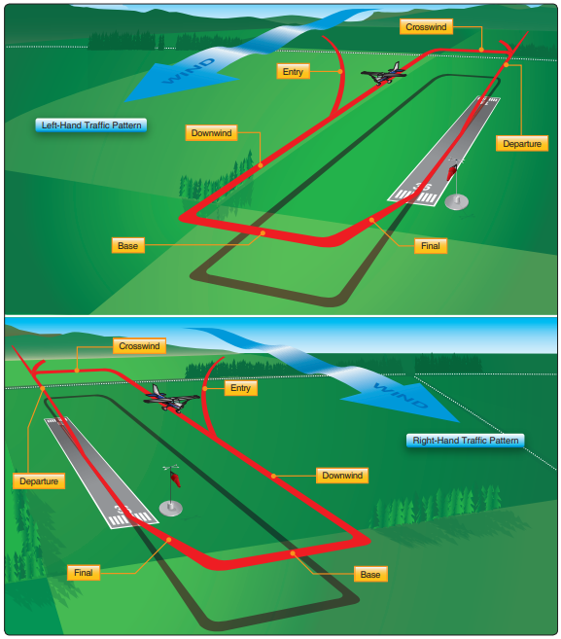
Proposals Subject to Notification
Change any traffic pattern or traffic pattern altitude or direction.

Slide 12
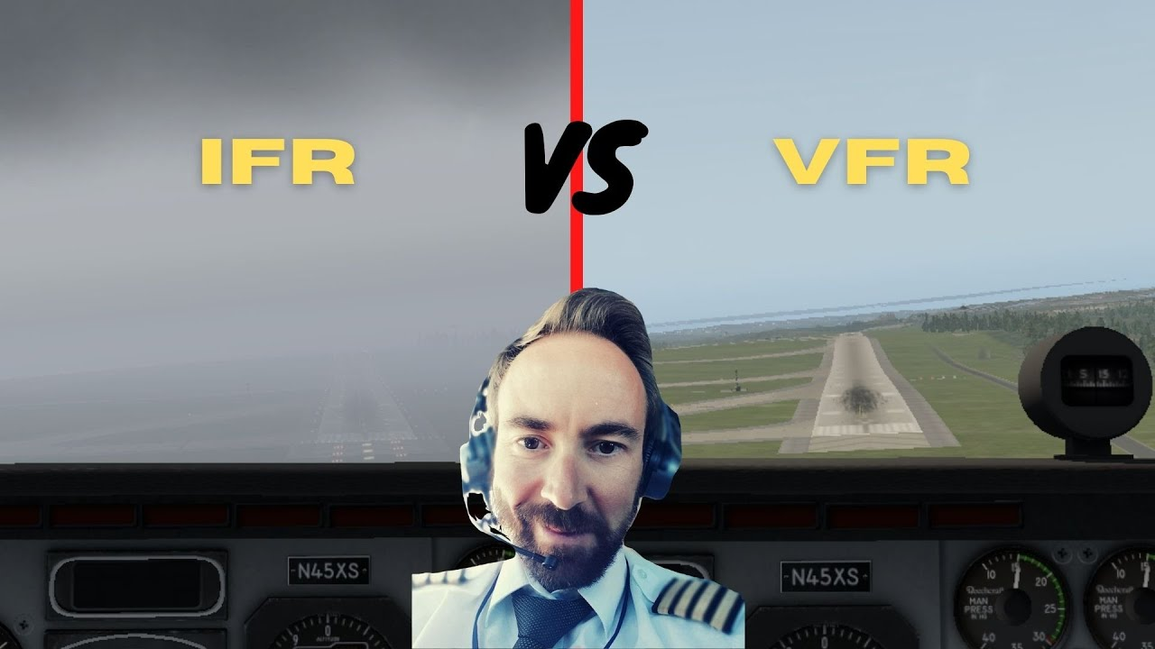
Proposals Subject to Notification
Change status from IFR to VFR or VFR to IFR.
VFR stands for Visual Flight Rules. IFR stands for Instrument Flight Rules. Depending on the weather conditions a pilot may opt for one set of rules or the other. Mostly, it's the weather that makes the pilot fly VFR or IFR.

Slide 13

FAA Determination
The FAA will conduct an aeronautical study of an airport proposal and issue a determination to the proponent.
The FAA will consider matters such as the effects the proposed action would have on existing or contemplated traffic patterns of neighboring airports; the effects the proposed action would have on the existing airspace structure and projected programs of the FAA; and the effects that existing or proposed manmade objects (on file with the FAA) and natural objects within the affected area would have on the airport proposal.
An airport determination issued under this part will be one of the following:
  No objection.
  (2) Conditional. A conditional determination will identify the objectionable aspects of a project or action and specify the conditions which must be met and sustained to preclude an objectionable determination.
  (3) Objectionable. An objectionable determination will specify the FAA's reasons for issuing such a determination.

Slide 14
Quiz
Given the following scenarios, determine if notice is required under Part 77 or Part 157.
  An non-obligated airport is notifying the FAA of a future runway extension.
  A public-use airport is notifying the FAA for a temporary crane being put up for a construction project.
  An non-obligated airport is notifying the FAA of their intent to change from a VFR to an IFR airport.
Part 157
Part 77
Part 157

Slide 15
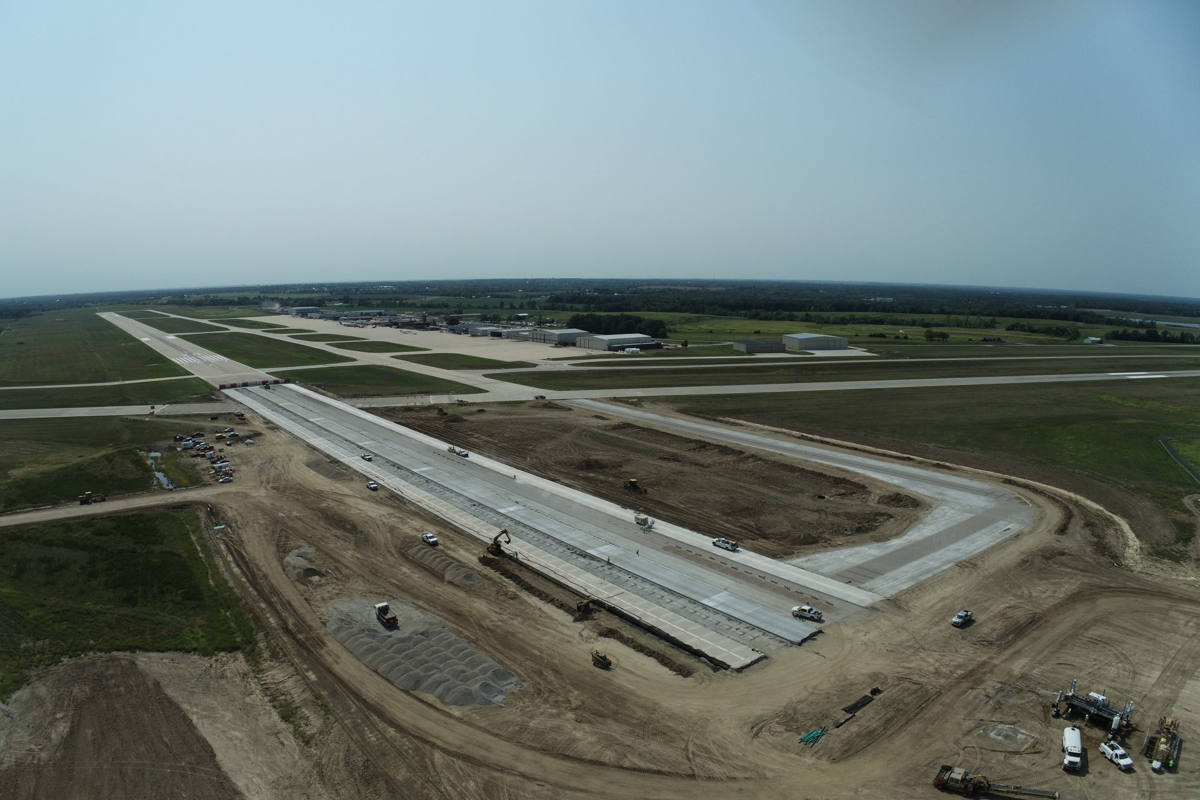
Group Discussion
Example: Runway Extension Project
OBLIGATED AIRPORTS | NON-OBLIGATED AIRPORTS
ALP REVISION | ADIP/FORM 7480-1 SUBMITAL FOR RUNWAY EXTENSION
FORM 7460-1 SUBMITTAL FOR RUNWAY EXTENSION | FORM 7460-1 SUBMITTAL FOR CONSTRUCTION ACTIVITIES (E.G. STOCK PILES) Public Use Facilities Only.
CSPP SUBMITTAL ASSUMING FEDERALLY FUNDED PROJECT
FORM 7460-1 SUBMITTAL FOR CONSTRUCTION ACTIVITIES (E.G. STOCK PILES)

Slide 16

Questions

