Slide 1
2023
Submitting an AMR project

Slide 2
AMR Module
2

Slide 3
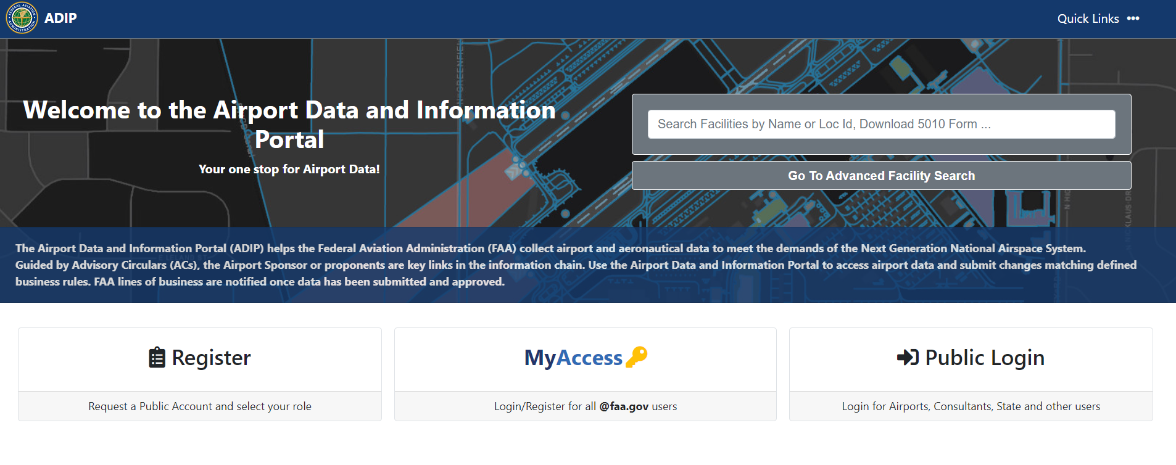
AMR Module – Registration and Login
Request a Public Account and select your User Role
FAA ADMIN and FAA Airports Regional and District Office Log In button
Airport Managers, State and Contractor Airport Inspectors, and State DOT employee Log In button
3

Slide 4
AMR - Field Permissions

Slide 5
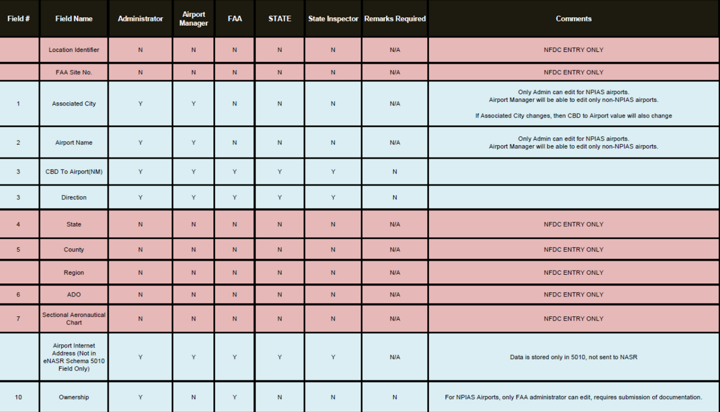
AMR - Field Permissions

Slide 6
ADIP AMR Module – Login for Public Users
Login page will display as below; Enter the email address and password assigned to your account and hit login.

Slide 7
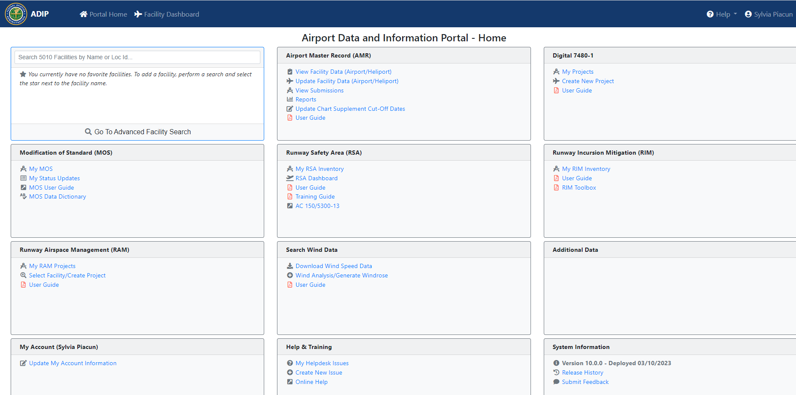
ADIP AMR Module
The Airport Master Record (AMR) module will display on the portal page.
Here you can View/Update a Facility, View your submissions and access the User Guide.

Slide 8
ADIP AMR Module – Updating a Facility
You will select the “Update Facility Data (Airport/Heliport)” to begin updating the airport/heliport.

Slide 9
AMR – Update Facility Data
Enter the airport LOC ID, select the submission type as ‘Inspection’ or “Additional Information” and click on ‘Start Update’ button.
Search by Airport Name
9

Slide 10
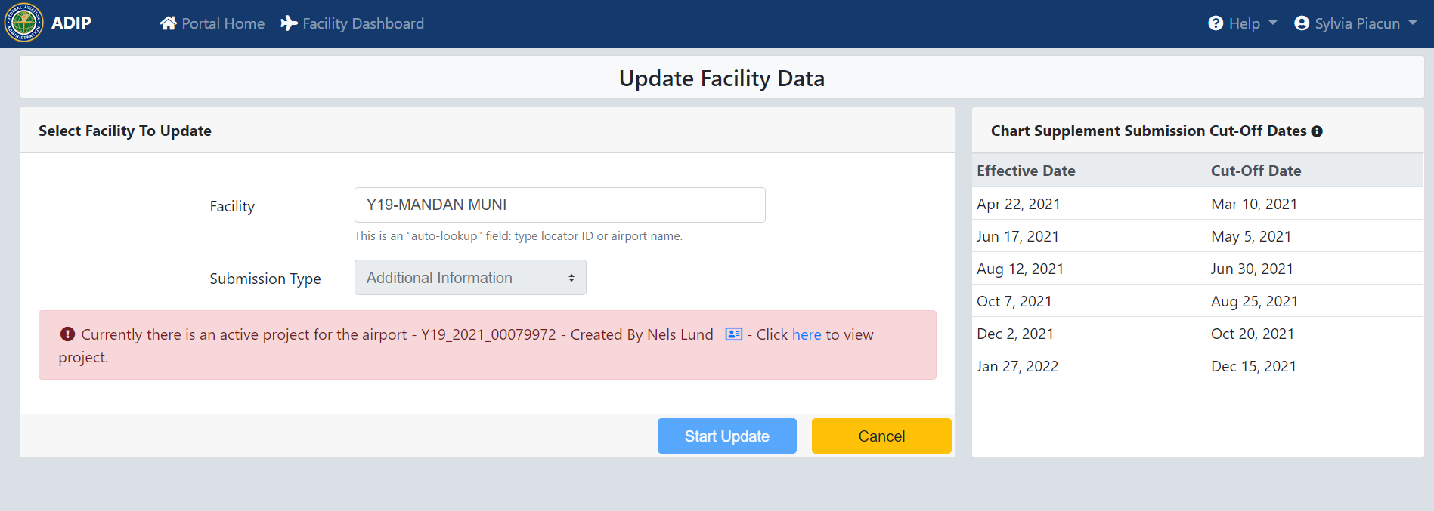
AMR – Update Facility Data
If this message is displayed, then someone else has created a project for that airport. You will not be allowed to make any edits until that person has submitted or terminated the project.
10

Slide 11
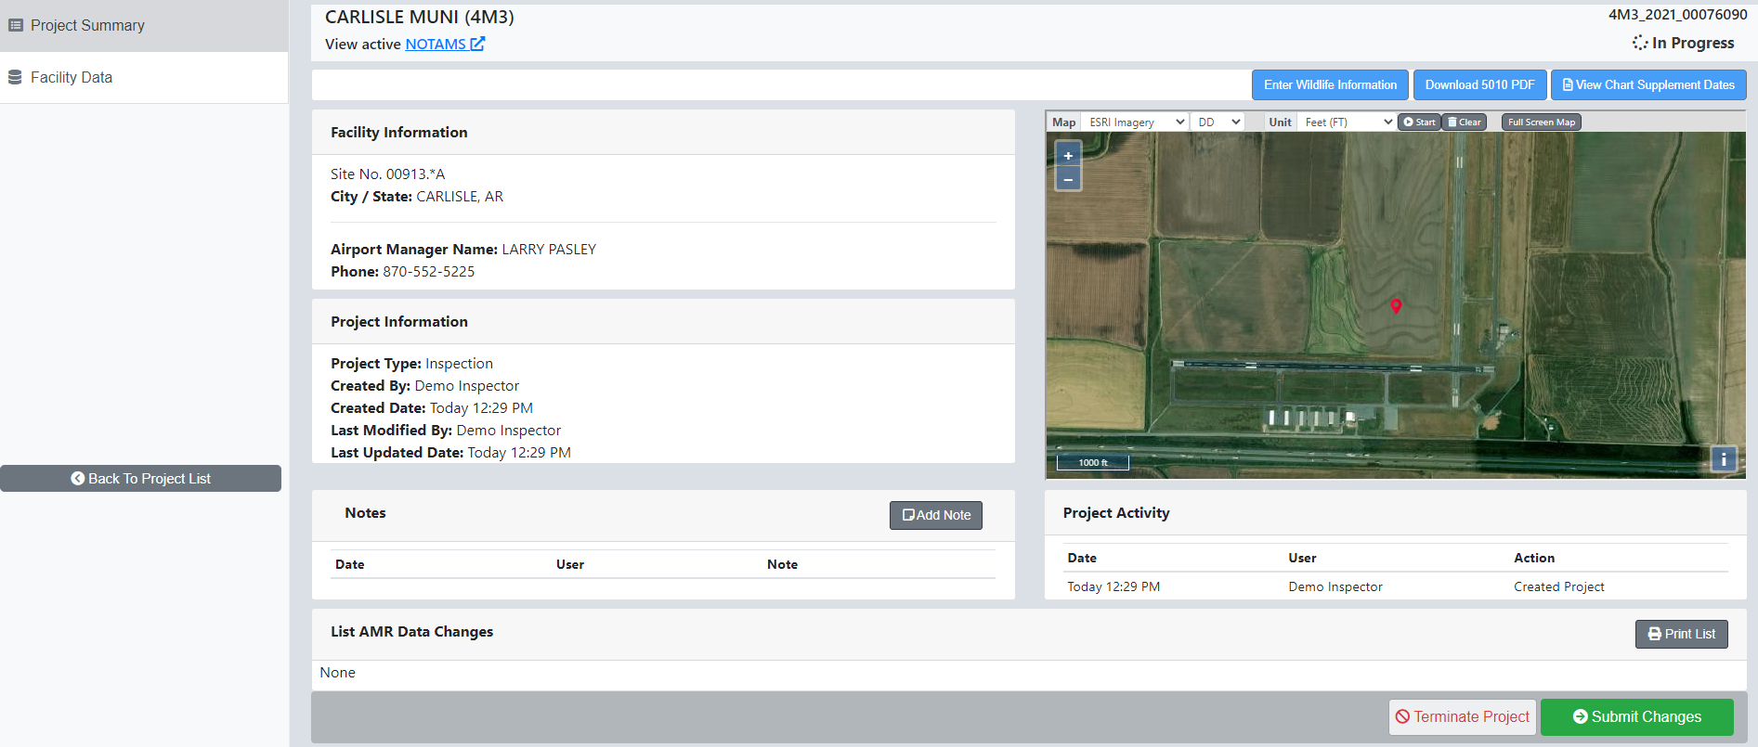
AMR – Project Summary Page
AMR Project Summary Page will display with Facility Information, Project Information and Project Activity. Click on “Facility Data” tab start updating the Airport data.
11

Slide 12
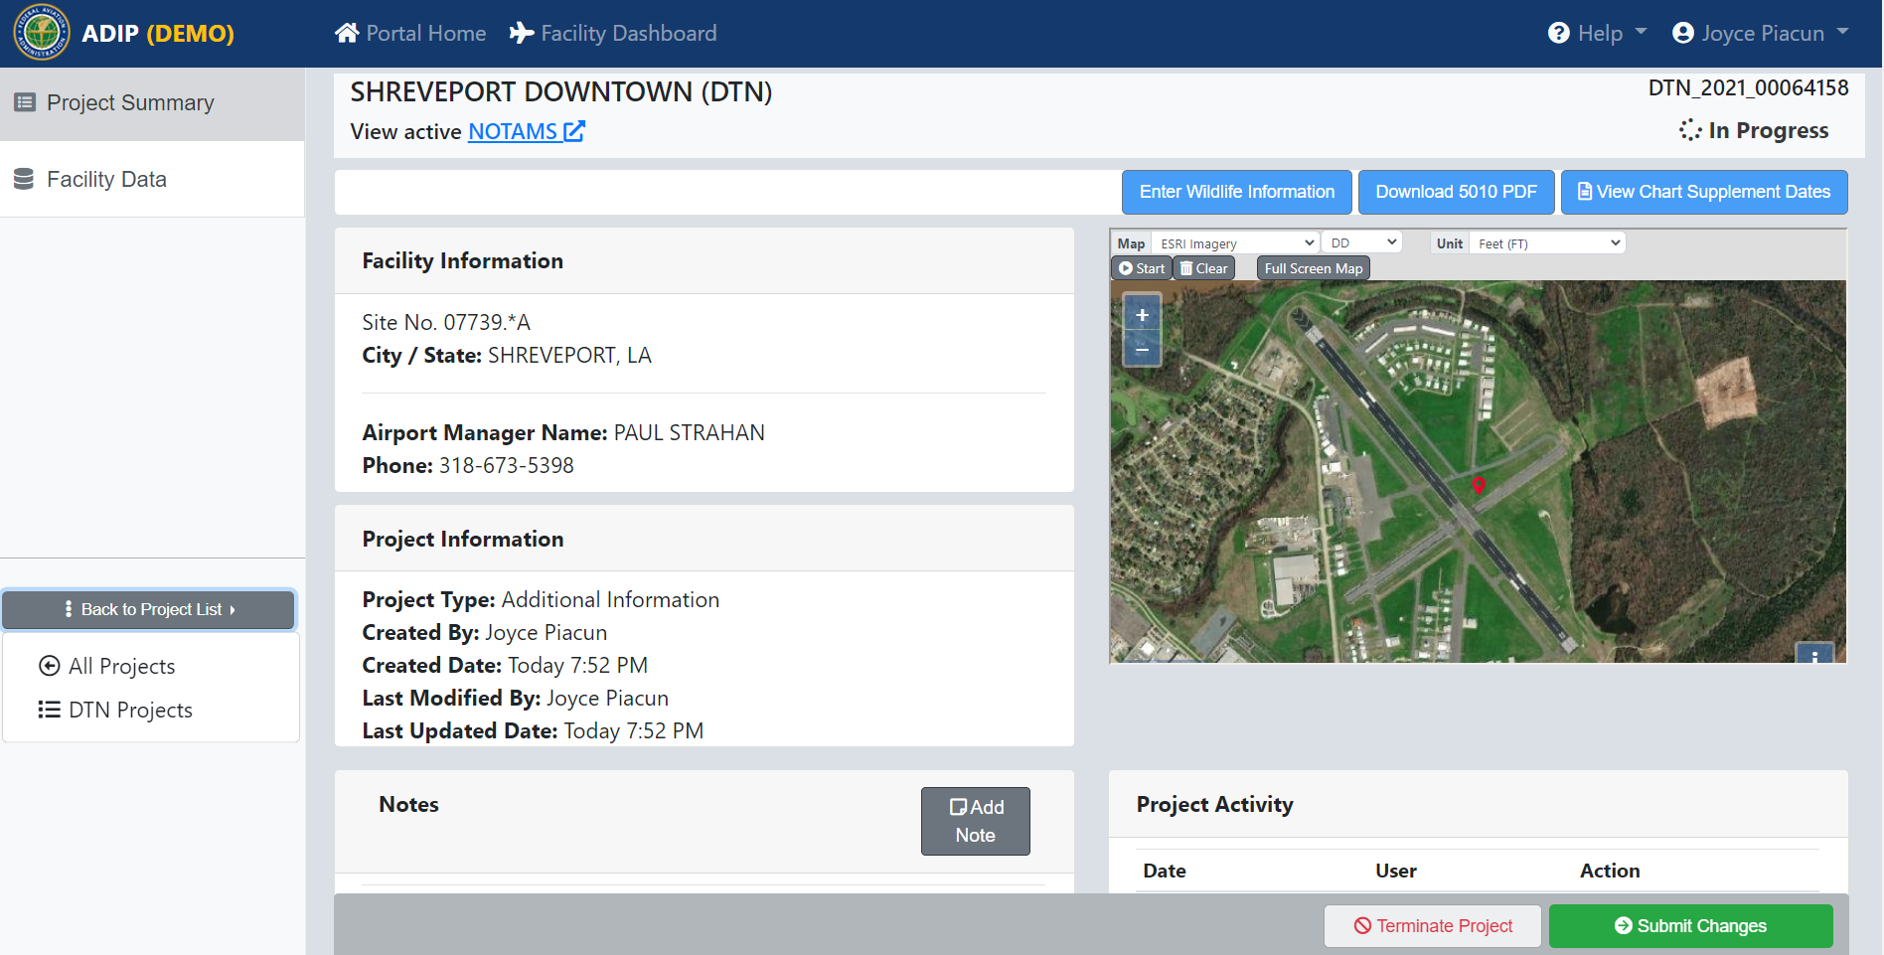
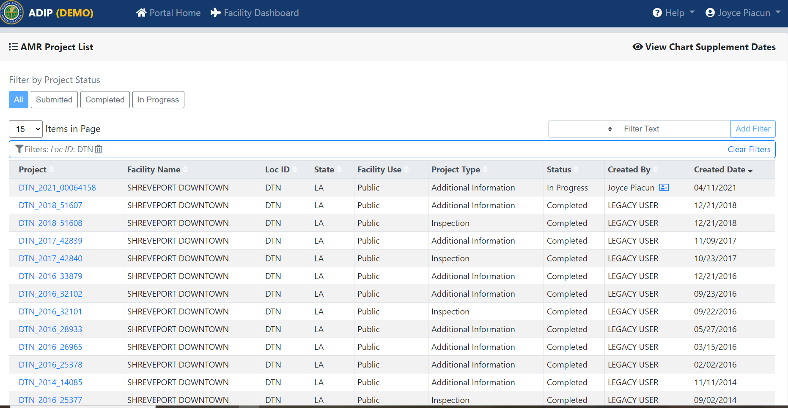
AMR – Project Summary Page
The Back to Project list dropdown will direct you to either see all your projects you have created or just the projects created for the selected facility.
12

Slide 13
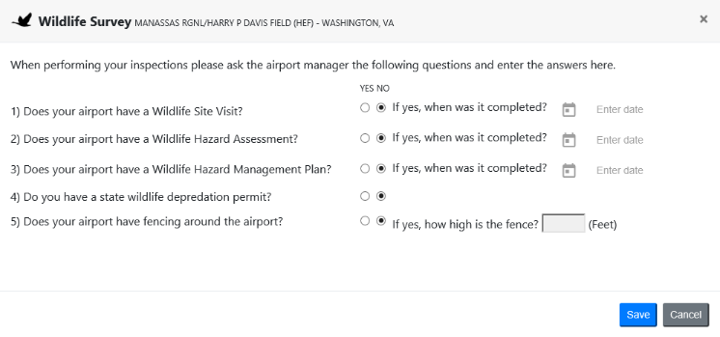
AMR – Download 5010 form
By clicking on the “Download 5010 PDF” you will get a current copy of the airport master record for the selected facility.
13

Slide 14
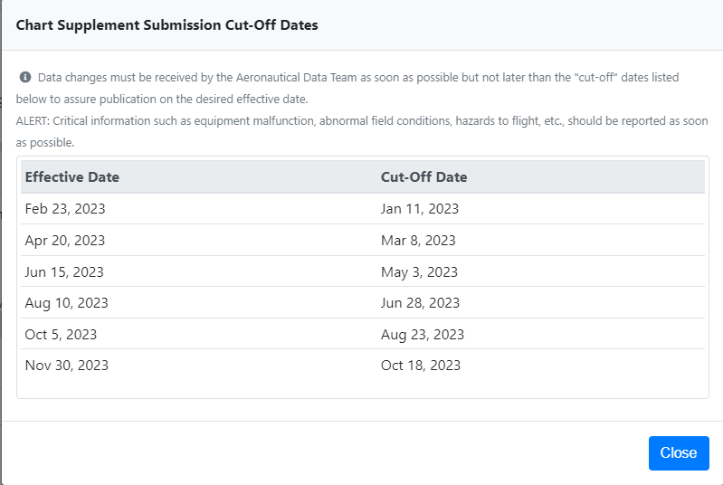
AMR – View Chart Supplement Dates
By clicking on the “View Chart Supplement Dates” will bring up a screen showing the Effective Dates and Cut-Off Dates.
14

Slide 15
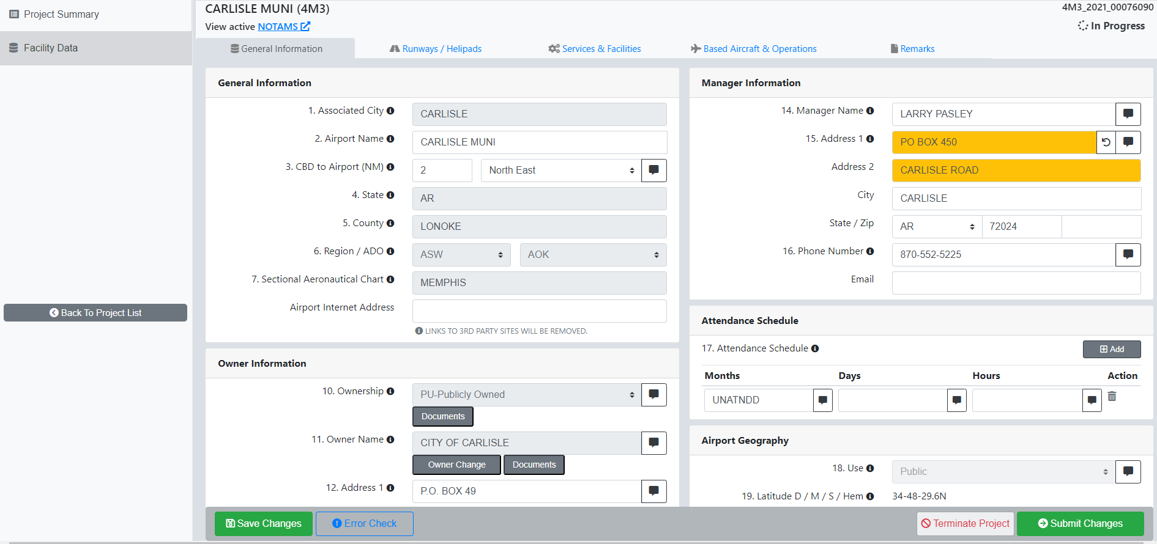
AMR – Facility Data
To start editing the airport data, you will need to click on the “Facility Data” tab.
15

Slide 16
AMR – Facility Data
The Facility Data page displays the General Information, Runways/Helipads, Services & Facilities, Based Aircraft and Remarks tabs.
16

Slide 17
AMR-Information
Every AMR field has an Info button. Click this button to view a pop-up with information about the field.

Slide 18
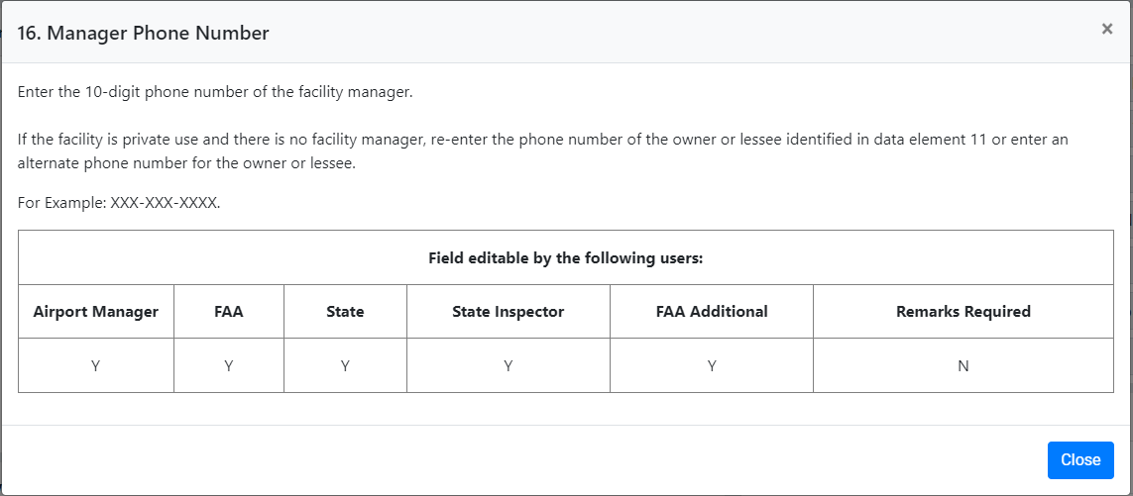
AMR-Information
Provides a description of the information to be entered in this field. Information pop-ups also provide information on who can update the field based on their user role.

Slide 19
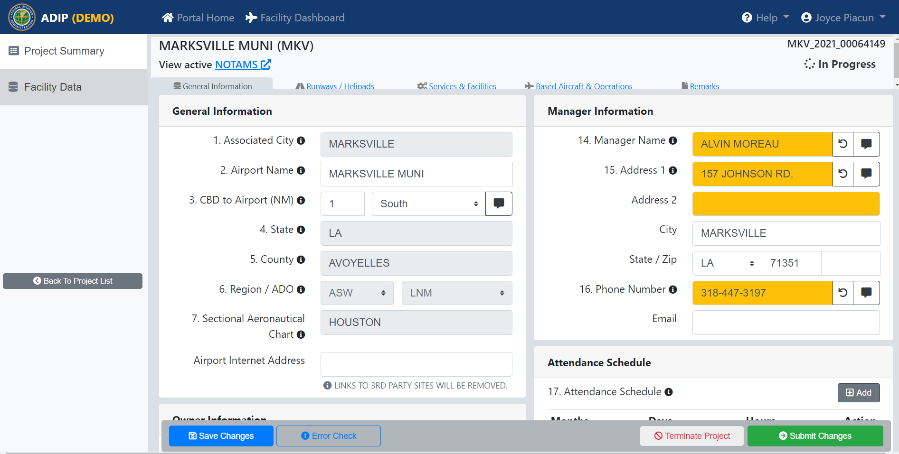
AMR – General Information Tab
The General Information Page displays General information about the airport.
On this page you can select the “NOTAMS” link to view active NOTAMS for the selected airport.
19

Slide 20
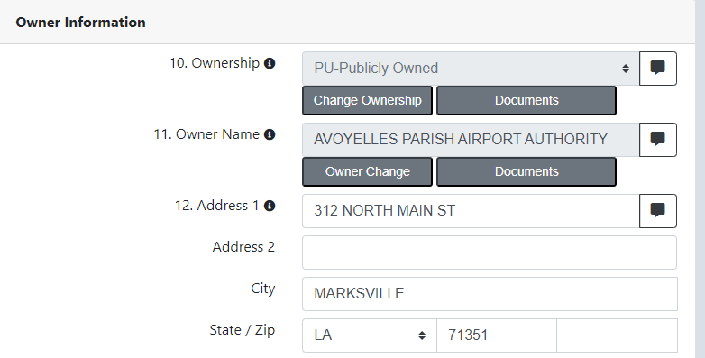
AMR – Ownership and Owner Name Change
On the General Information Tab, you can change the Ownership and Owner Name which require additional documentation. Select the “Change Ownership” or “Owner Change” button and you will be prompted to submit the required documents for those changes.
20

Slide 21
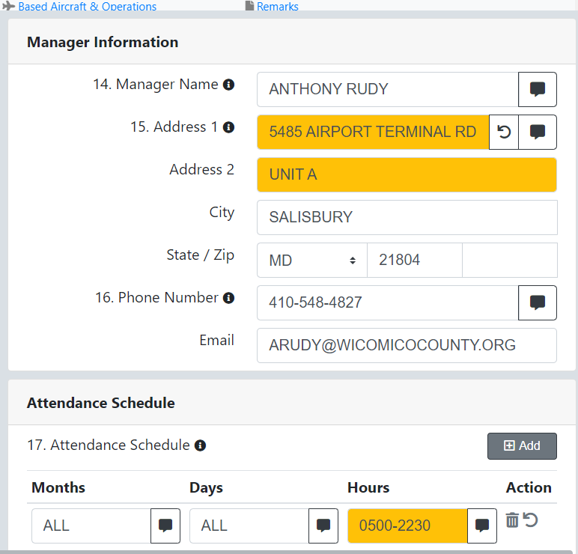
AMR - Comparing your changes with current FAA data
When a saved value differs from the current published data, field is highlighted in yellow.
Hover mouse over highlighted field to view comparison window.
If you want to revert to the currently published data, click on the reverse arrow and save changes.
21

Slide 22
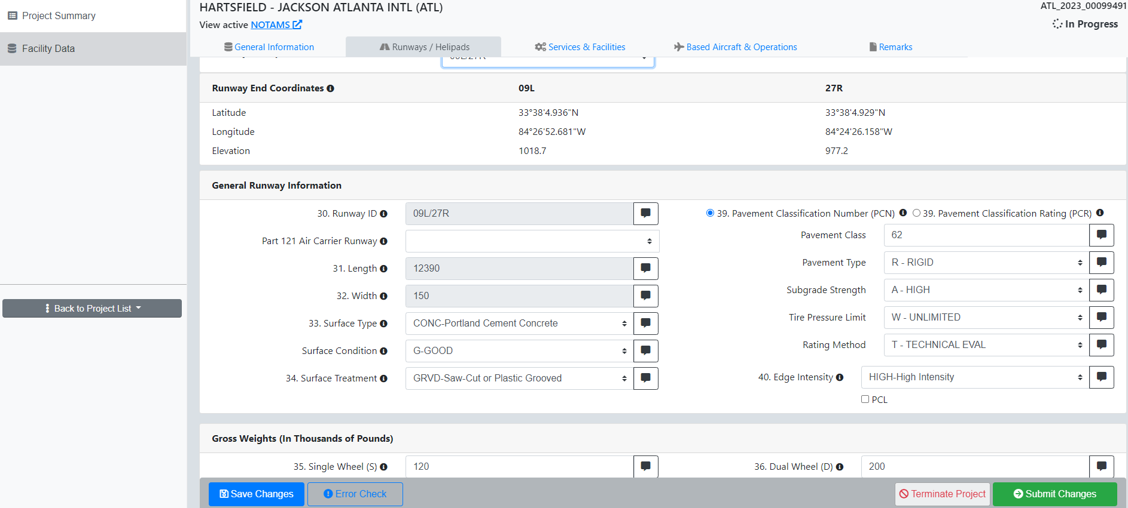
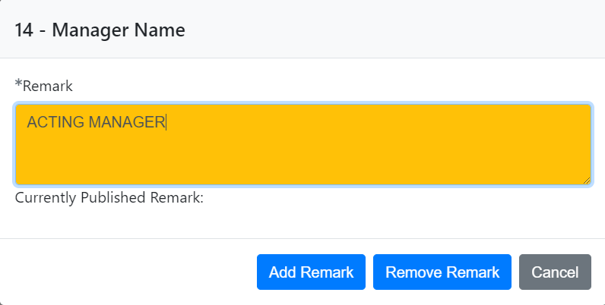
AMR – Adding a Referenced Remark
Select the “Remark” icon button to the right of the data element to access the Reference Remark window.
Enter the remark in the space provided and select the “Add Remark” button to save your changes.
22

Slide 23
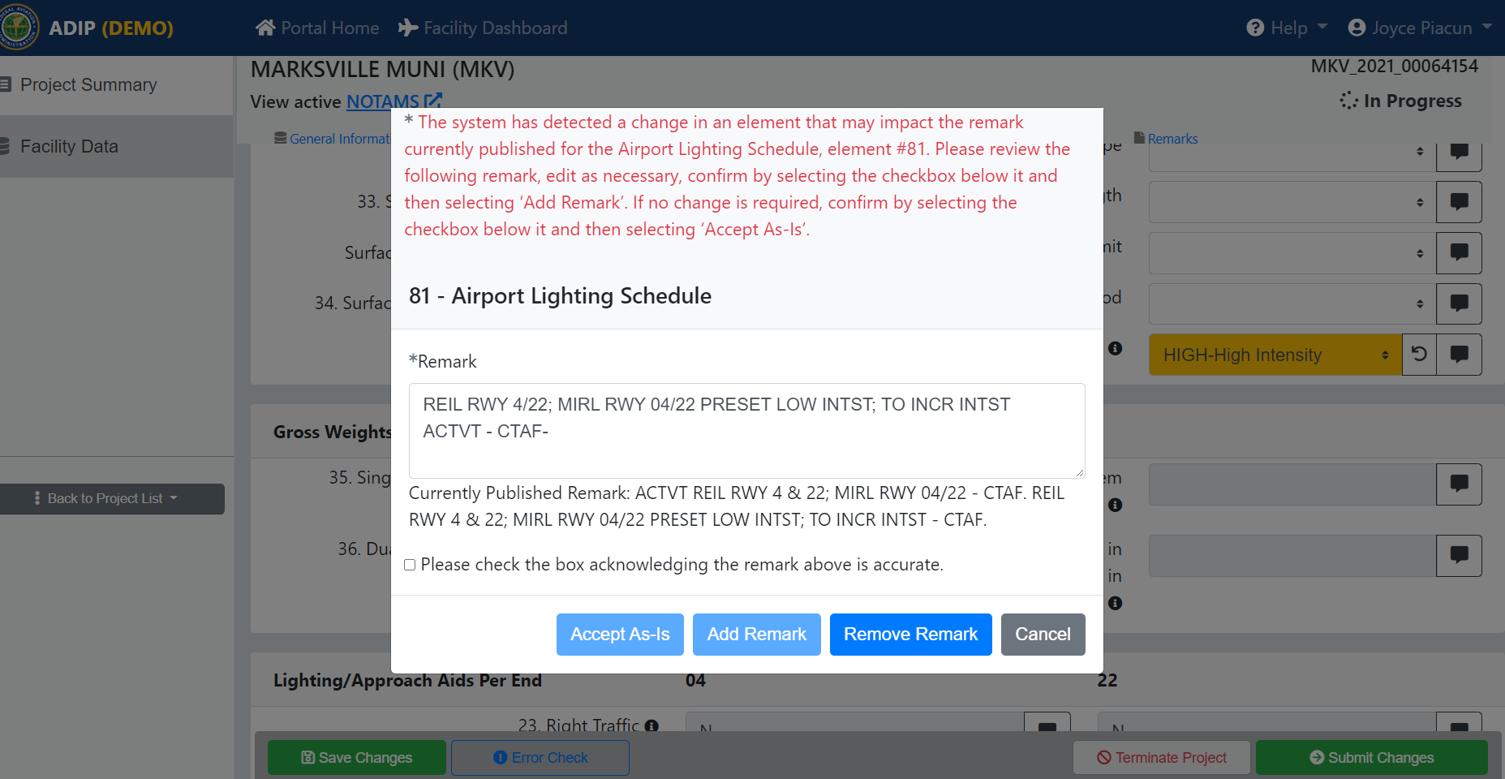
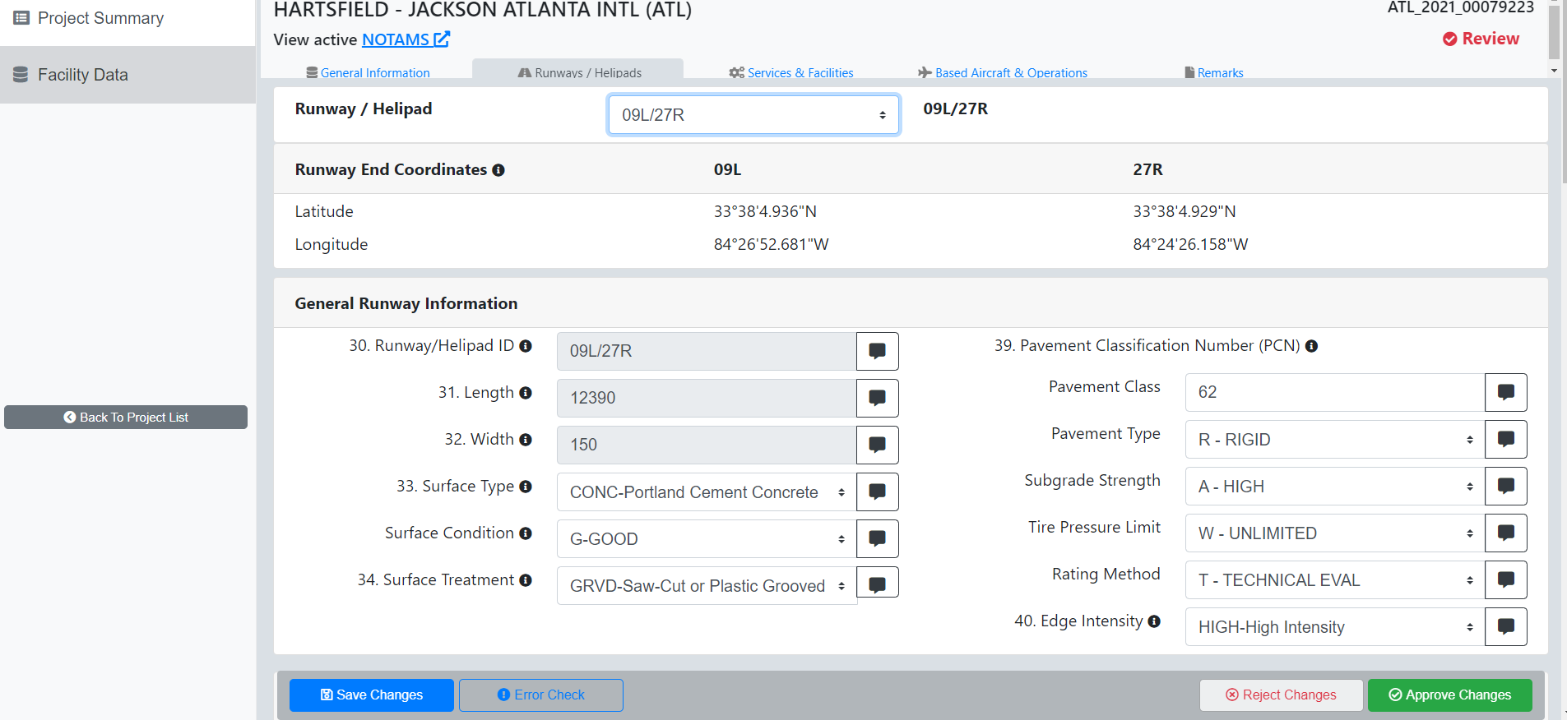
AMR – Adding a Referenced Remark
When adding or changing a data element associated with the “Airport Lighting Schedule” it will require a remark.
The Reference Remark window will pop-up. Enter the remark in the space provided or edit the current remark. If no change is required select the “Accept As-Is” and save your changes.
23

Slide 24
AMR – Deleting a Referenced Remark
When deleting a data element associated with the “Airport Lighting Schedule” you will be required to remove the existing remark.
The Reference Remark window will pop-up. Select the “Remove Remark” and save your changes.
24

Slide 25
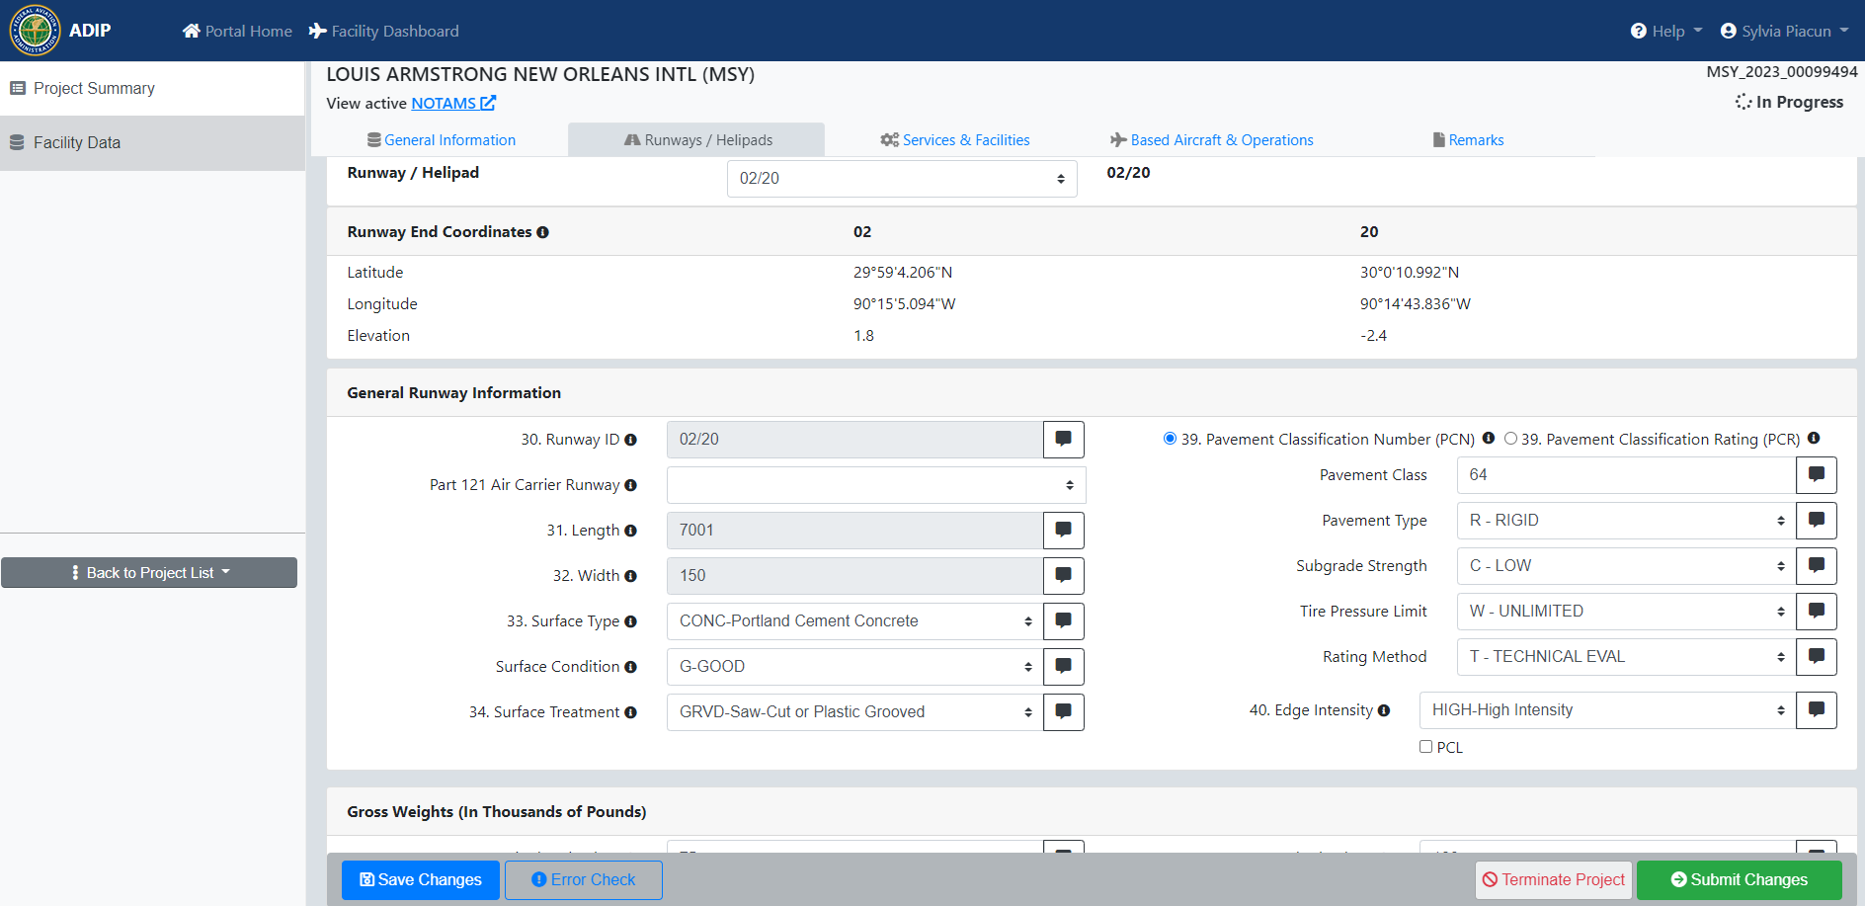
AMR – Runway/Helipads Tab
The Runways/Helipads Page displays all data associated with the landing areas.
Remarks for individual fields are displayed in the remark icon to the right.
25

Slide 26
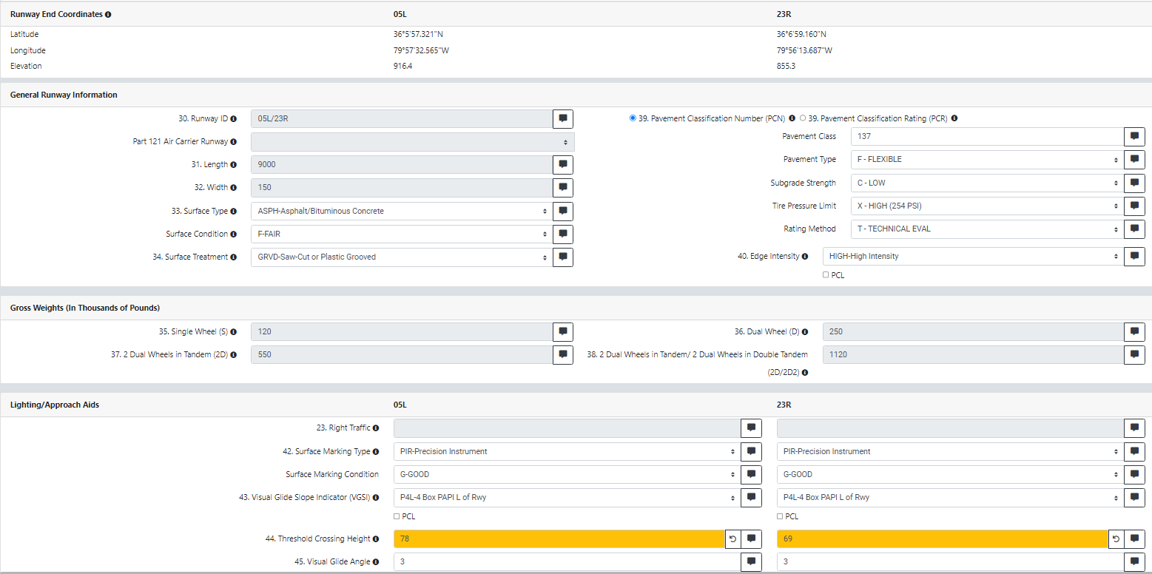
State DOT editable RWY fields
Surface Type and Condition
Surface Treatment
PCN/PCR
Edge Light intensity
Surface Marking type and Condition
VGSI
Threshold crossing height and glide angle
Centerline and TDZ lights, PCL
RVRs, REILs, and Approach lights
Part 77 Category
Controlling Obstruction and associated fields
* Grayed out boxes not editable by user

Slide 27
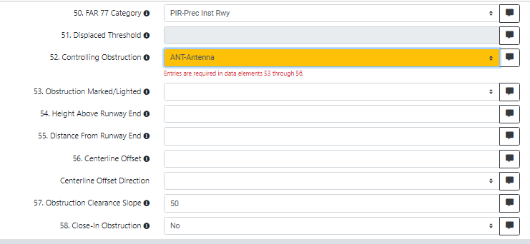
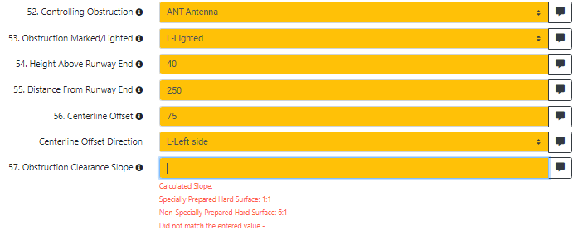
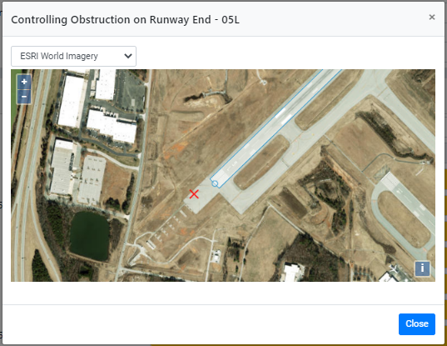
Controlling Obstruction
When adding a controlling obstruction, multiple data entries are required.

Slide 28
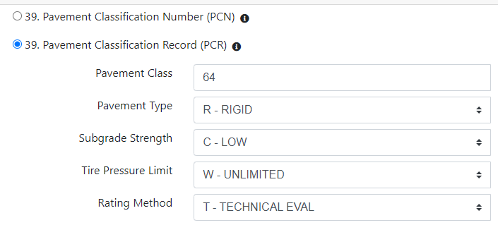
AMR – PCR/PCN
Users have the option of selecting Pavement Classification Number (PCN) or Pavement Classification Record (PCR) for reporting runway pavement data. Only one pavement type can be entered per Runway – PCN or PCR.

Slide 29
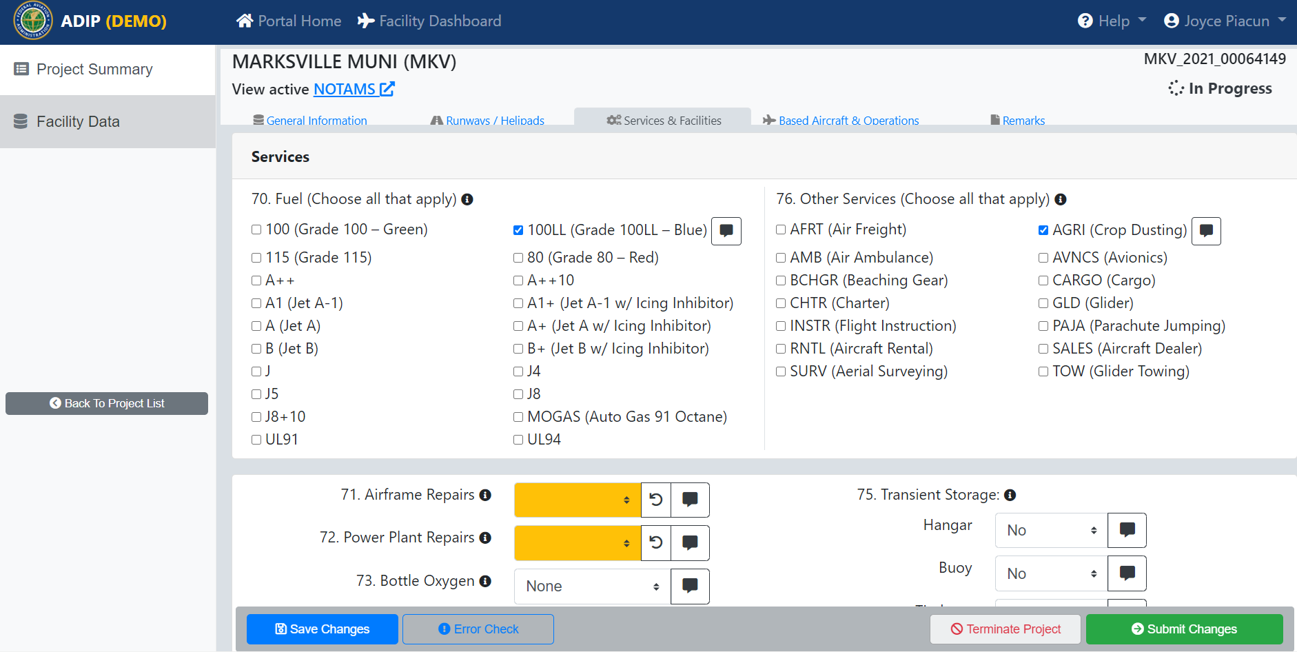
AMR – Services & Facilities Tab
The Services & Facilities page displays additional information about the airfield.
Remarks for individual fields are displayed in the remark icon to the right.
29

Slide 30
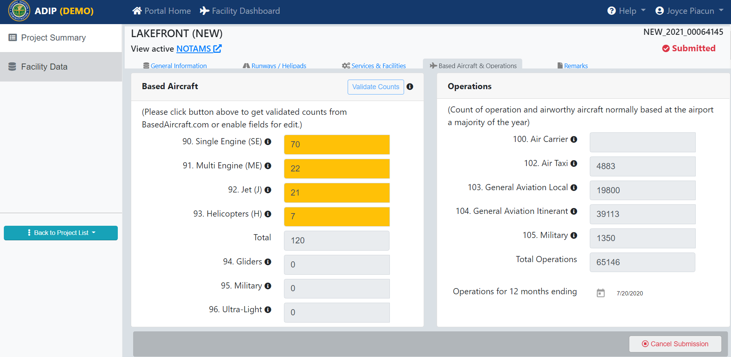
AMR – Based Aircraft & Operations
The Based Aircraft & Operations page displays based aircraft numbers and operations counts. For all non-Primary NPIAS airports, this data must be updated using basedaircraft.com. All other airports can enter data manually.
30

Slide 31
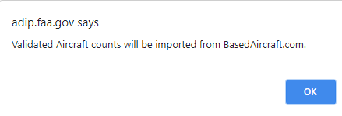
AMR – Based Aircraft & Operations
By clicking on the “Validate Counts” button a window will pop-up, if the selected facility is in the Based Aircraft website you will see the screen on the right. Click the “OK” button to pull in the current validated counts and save your changes.
31

Slide 32
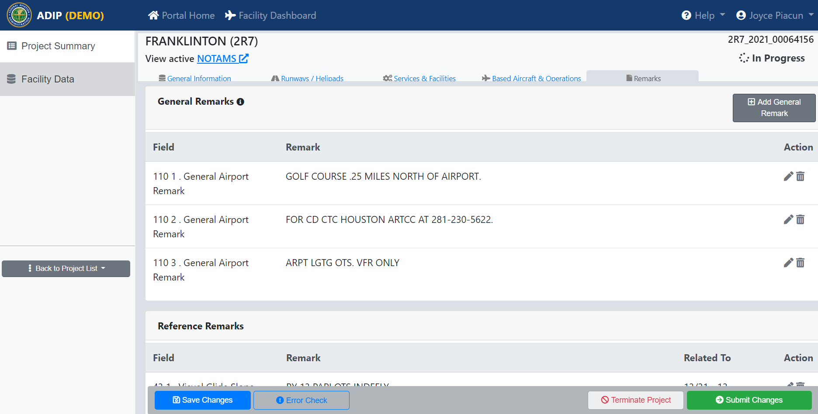
AMR – Remarks
The Remarks page represents one screen location allowing you to view, edit and delete remarks for specific individual date elements OR view, edit and delete for Airport General Remarks.
32

Slide 33
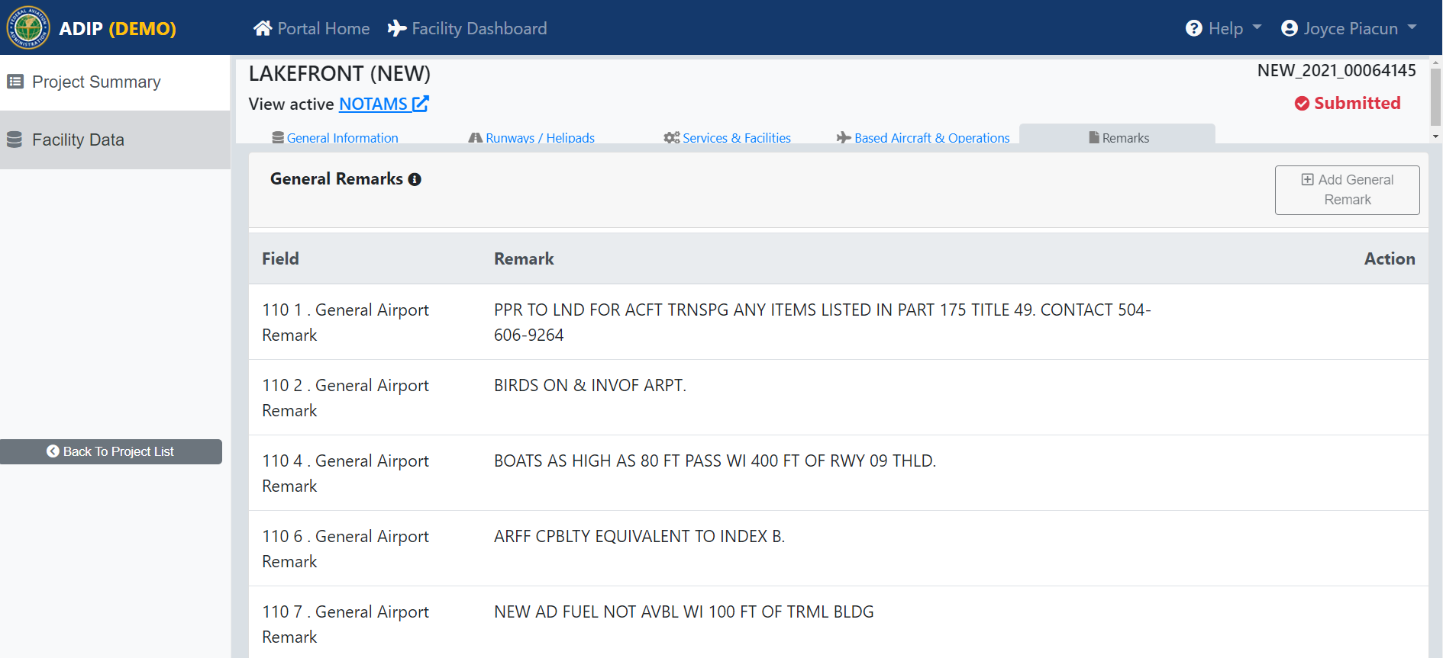
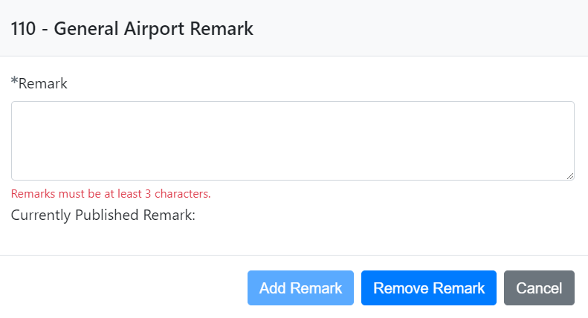
AMR – Adding General Remarks
Select the “Add General Remark” button to access the General Airport Remark window.
Enter the remark in the space provided and select the “Add Remark” button.
33

Slide 34
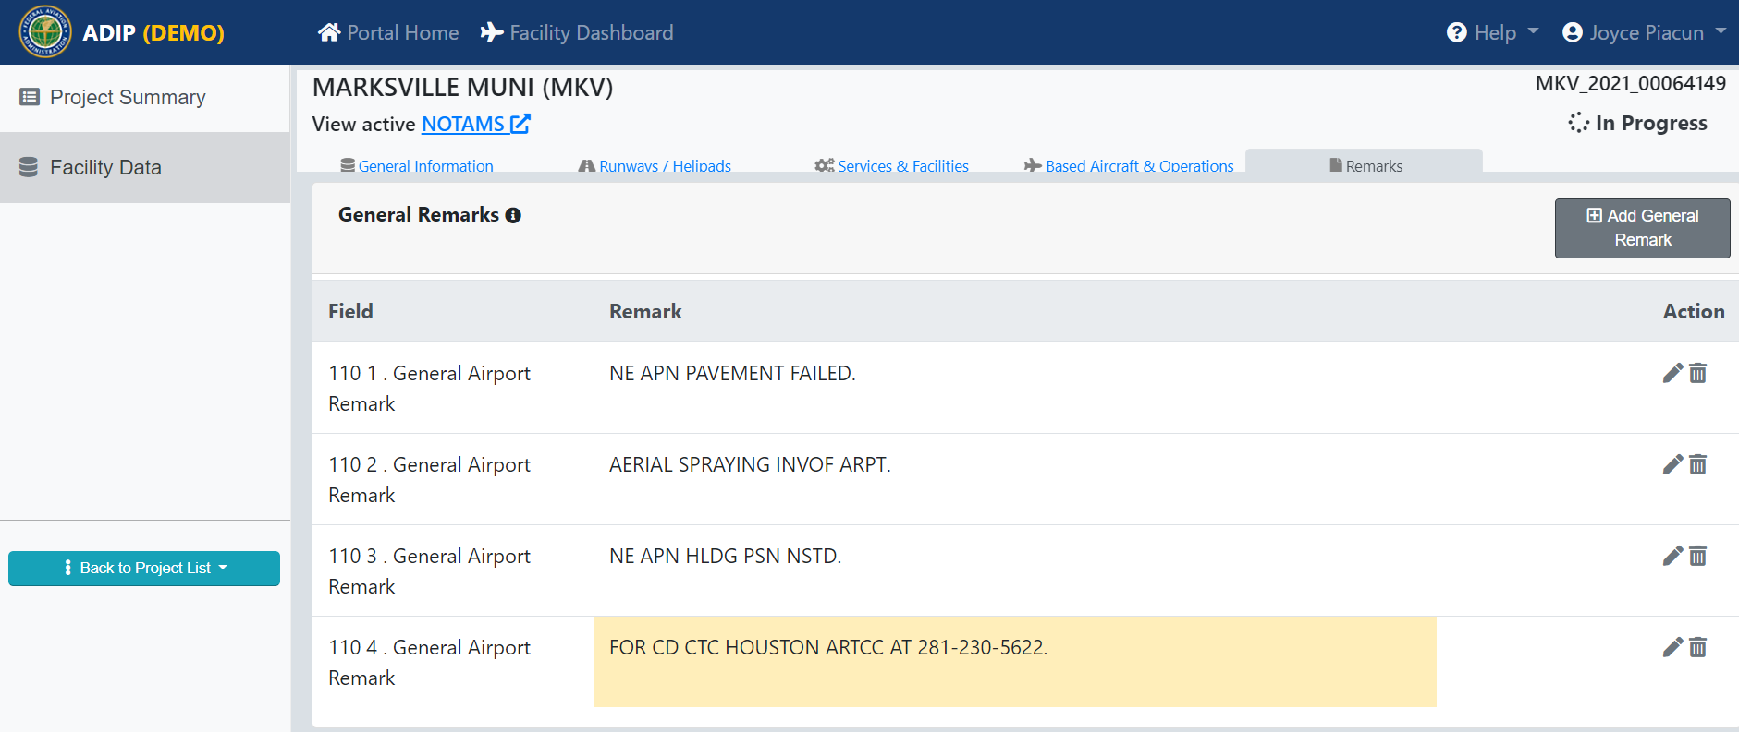
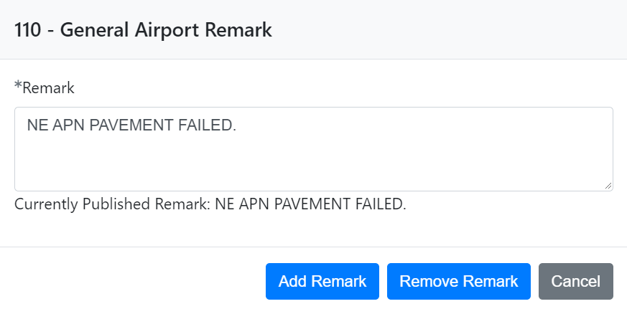
AMR – Editing or Deleting Remarks
To edit a remark, click on the “Pencil” icon, a screen will pop-up that will allow you to make edits. After you edit the remark, Click on the “Add Remark” button to add the remark. If you need to delete a remark, click on the “Delete” icon and the program will ask you “Delete Remark” and click on either “Yes” or “No”.
34

Slide 35
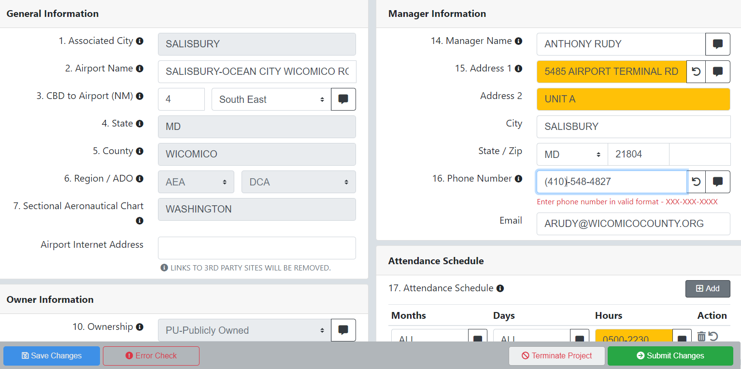
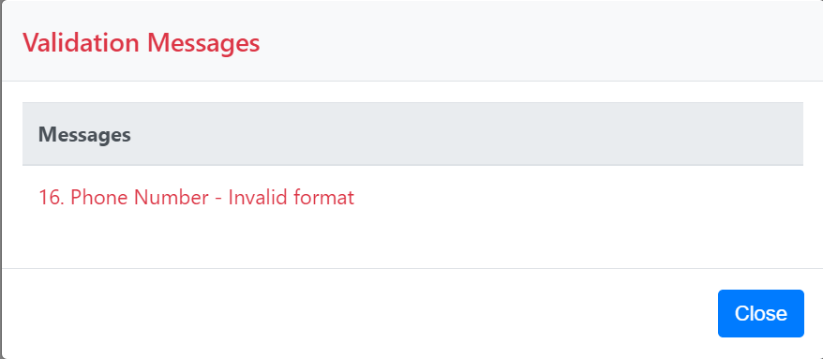
AMR – Error Check
If there is an error in any of the data, you will see the “Error Check” button on the bottom of the screen. You cannot submit your changes until you fix the error.
Click on the “Error Check” button to see the validation message.
Make the appropriate changes and click on “Save Changes”.

Slide 36
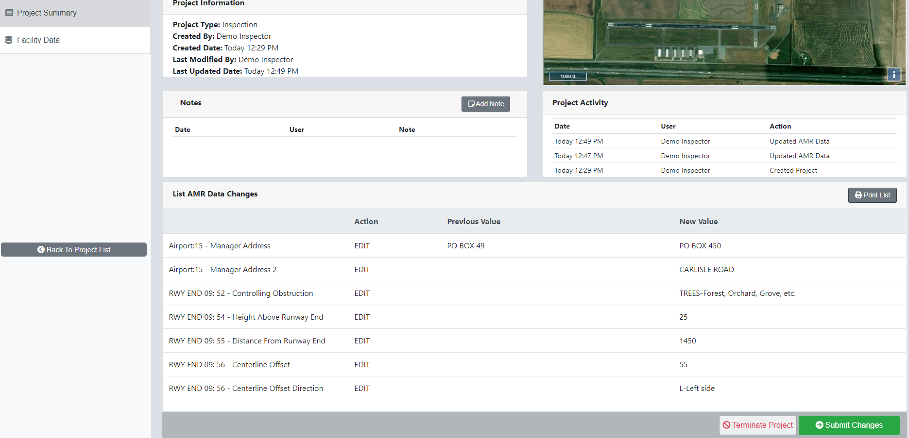
AMR – Project Summary Page
After you have entered your data changes and before you “Submit” them you can click on the “Project Summary” page. This will list all changes made for this airport. Review your changes and click ‘Submit Changes’ when ready.
36

Slide 37
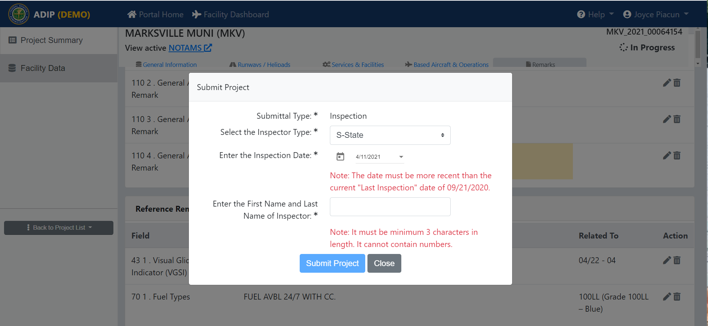
AMR – Submit Project Page
When selecting the “submit changes” button the screen on the right will pop-up if this was for an inspection.
Enter the requested information and select the “Submit Project” button.
37

Slide 38
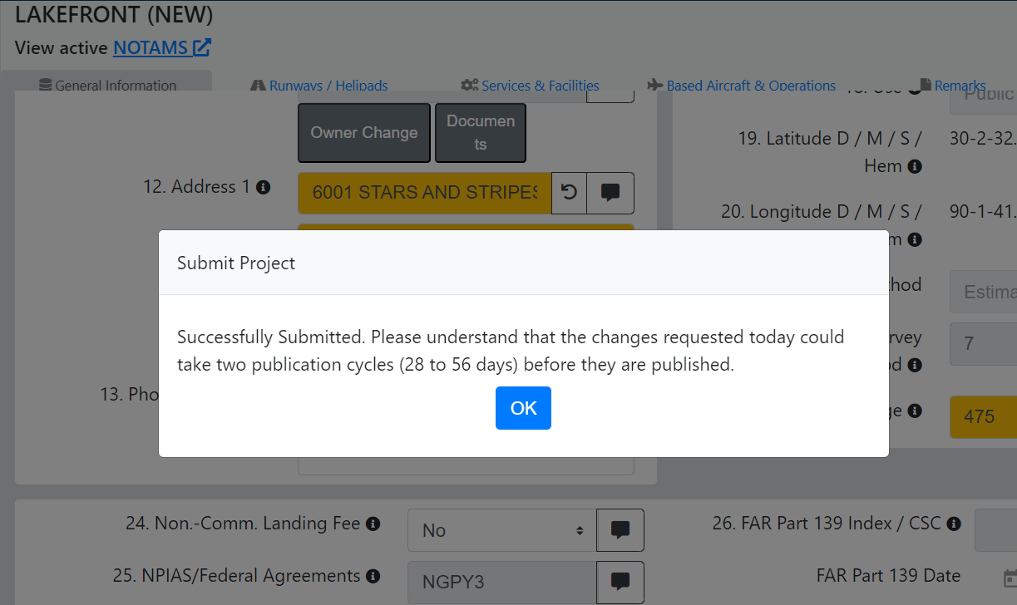
AMR – Submit Project Page
After submitting your updates for the facility, you will receive this message. Click “OK” and you will be brought back to Project Summary Page.

Slide 39
AMR – Cancel Submission
If you submitted your changes by mistake, selecting the “Cancel Submission” button will allow you to recall your submission and you can make other changes and then you can submit again.
This feature is only available until a Project Reviewer opens the project for review and submission.

Slide 40
AMR - Terminating a Project
If you wish to cancel all your changes and start with a new project, select “Terminate Project” by clicking on the “Terminate Project” button.
40

Slide 41
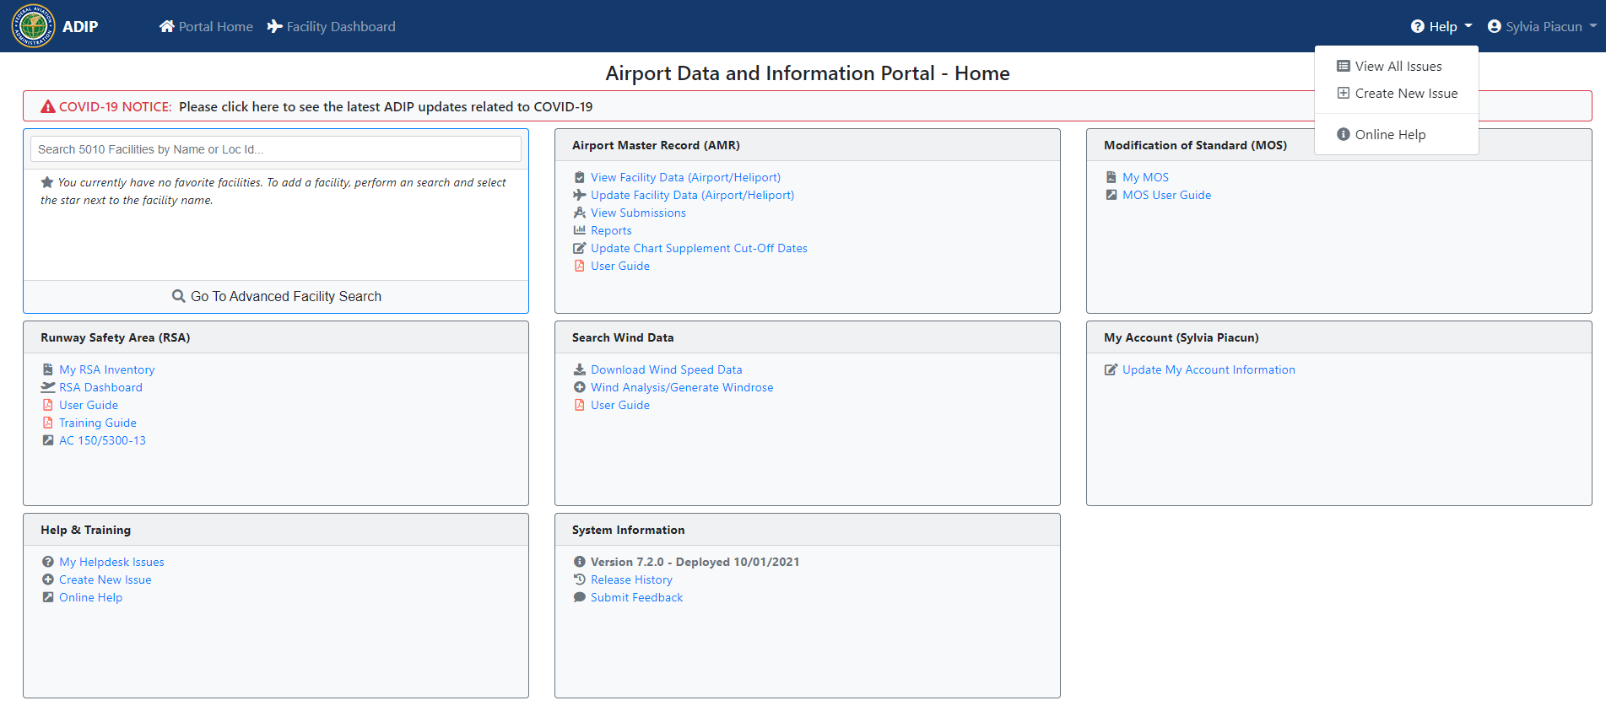
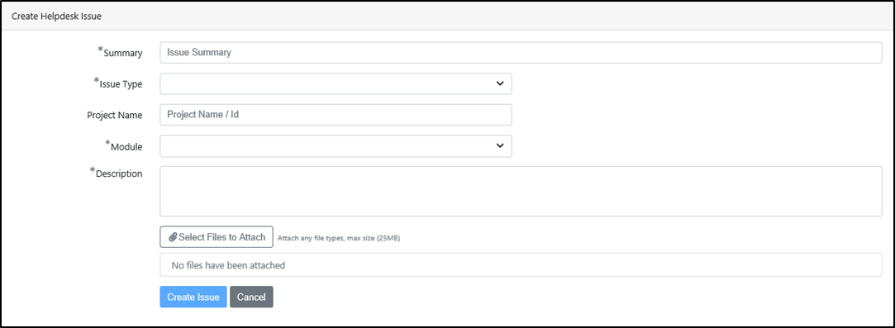
AMR – Online Help Options
Selecting the “Help” icon in the upper right corner will access the help options menu.
By selecting the “Create New Issue” a screen will pop up and allow you to create and submit a new helpdesk issue.

Slide 42
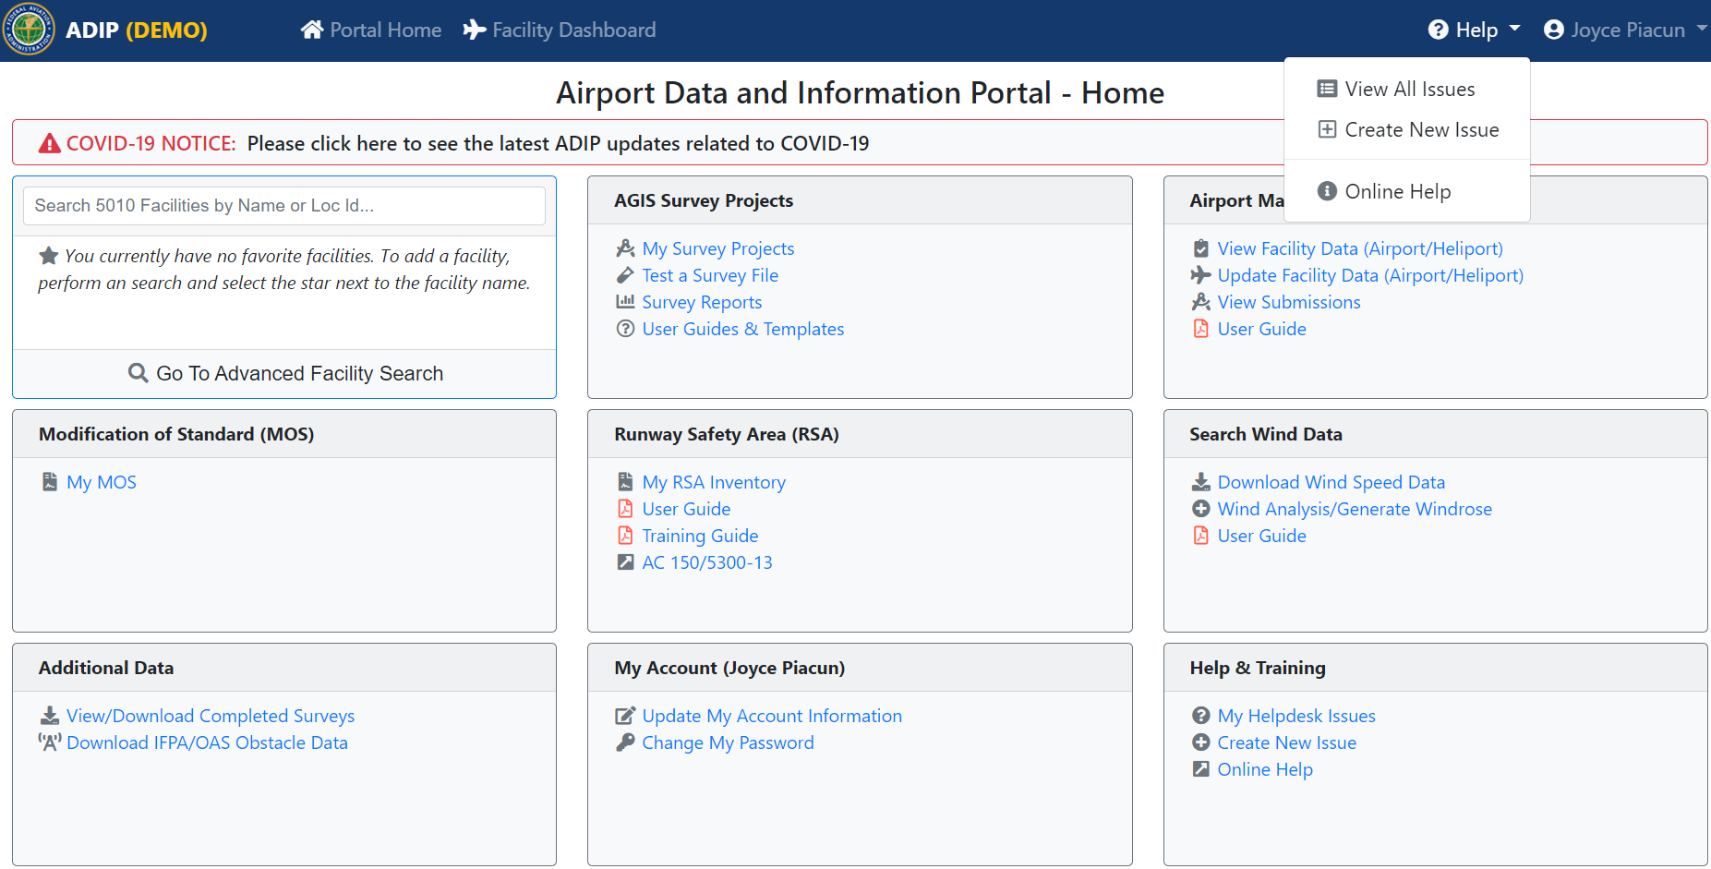
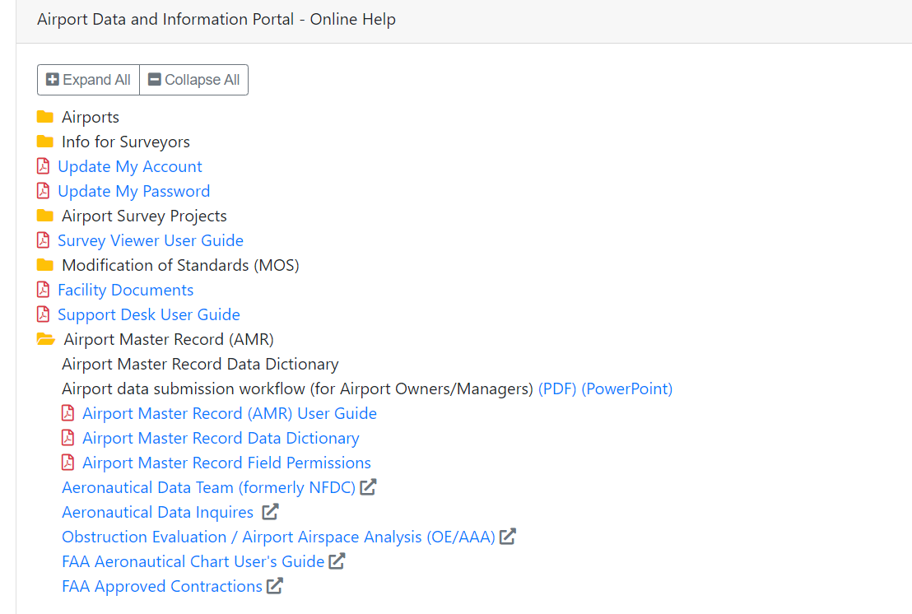
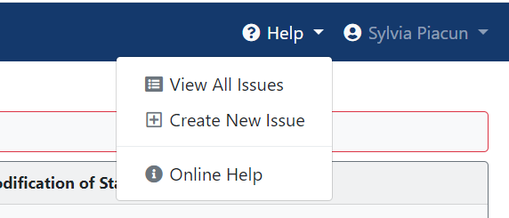
AMR – Online Help Options
Select the Airport Master Record “Online Help” link in the Airport Master Record (AMR) section of the ADIP home page. This will bring up a list of user guides and support documentation.

Slide 43
AMR – Facility Dashboard
Select the Airport Master Record “Facility Dashboard” link on the Airport Master Record (AMR) home page. Enter a LocID to access an airport’s Facility Details, Surveys, Facility Map and Charts.

Slide 44
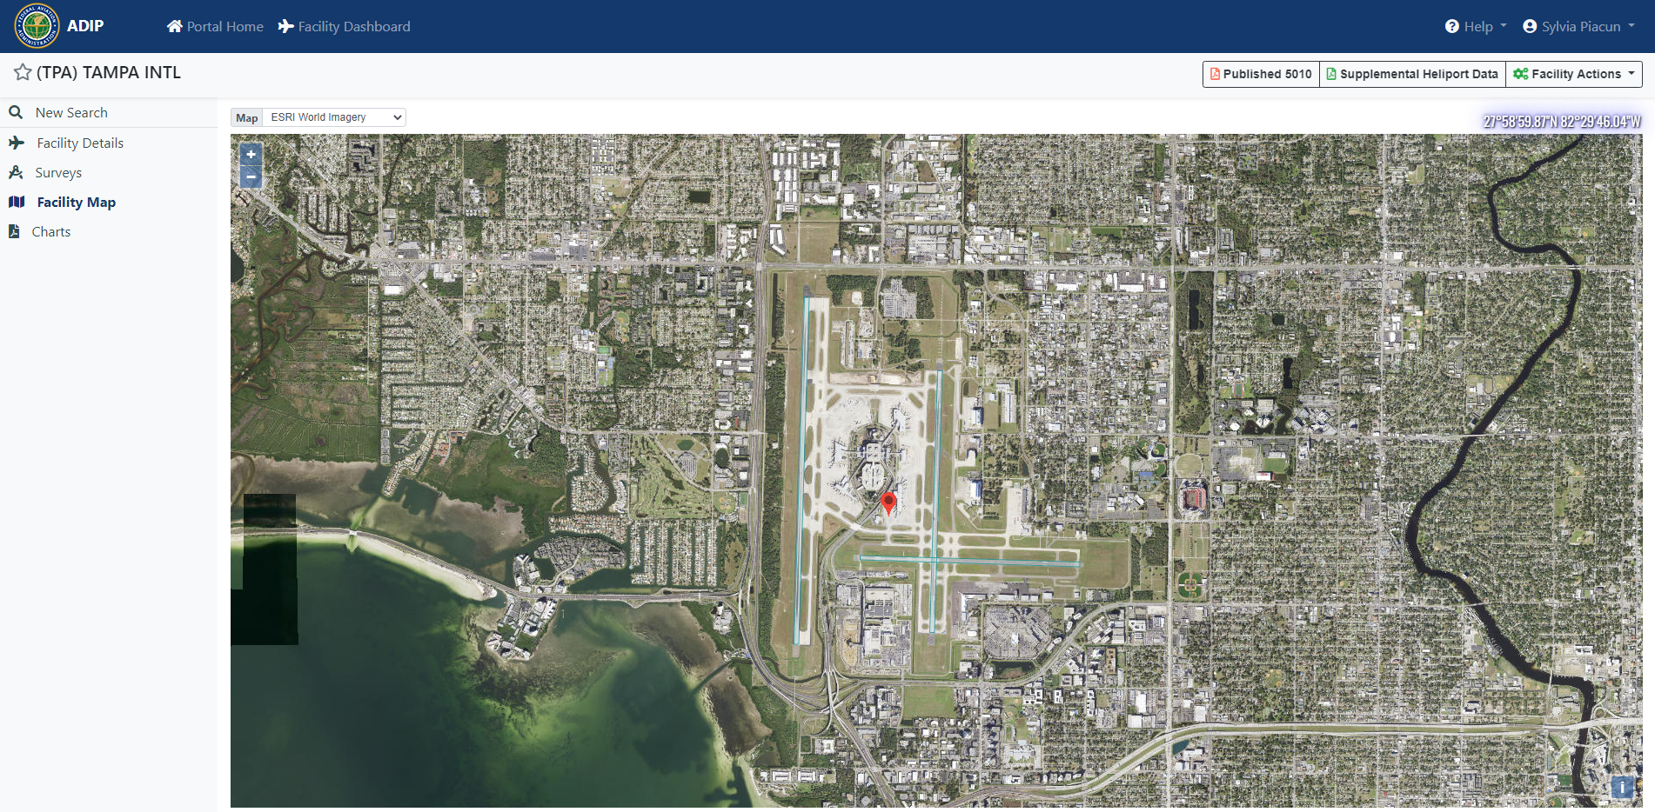
AMR – Facility Dashboard
Once on the “Facility Dashboard” you can select the links to access an airport’s Facility Details, Surveys, Facility Map and Charts. You can also download a copy of the current airport master record (5010).

