Slide 1
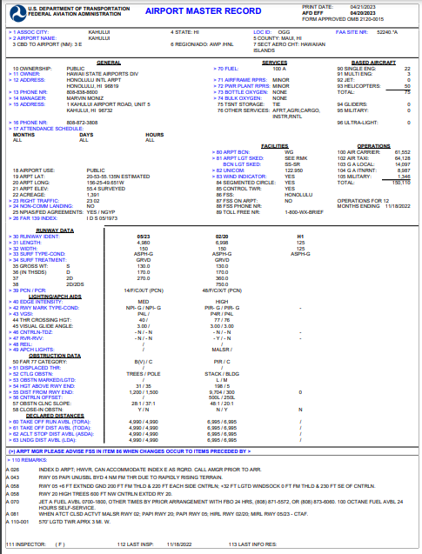
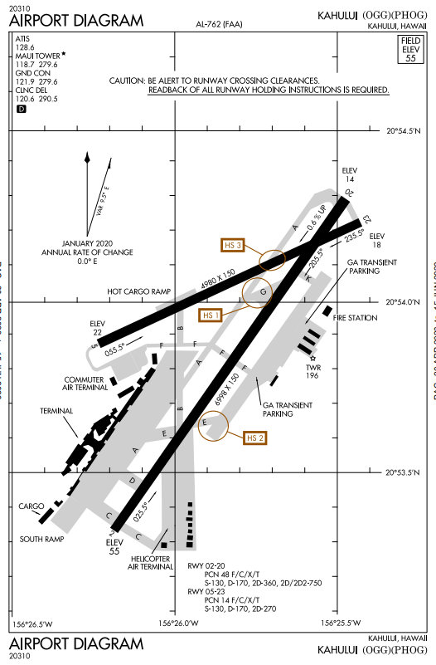
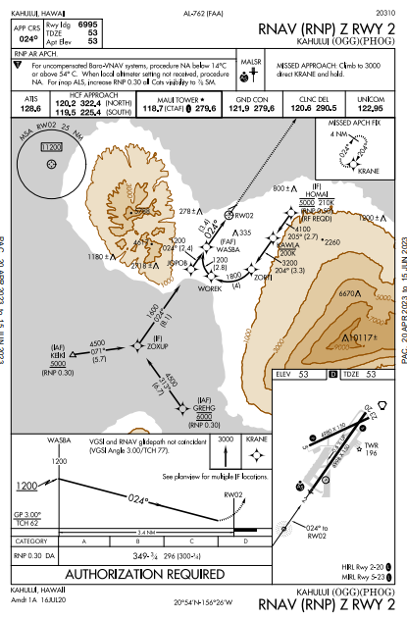
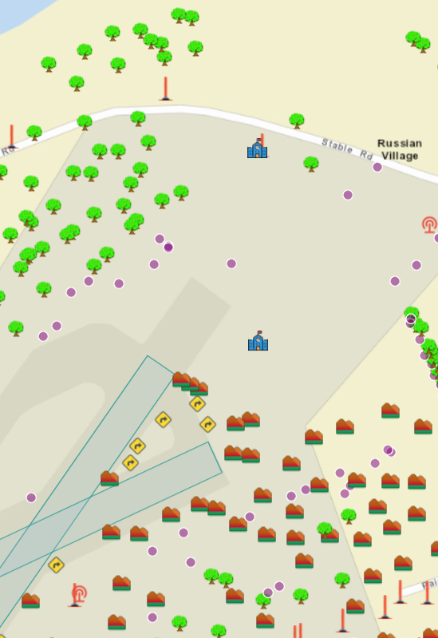
Aeronautical Data Chain
Office of Airports
FAA/DoD
Office of Airports
AJV-A
7480-1
RAS
ADIP
AMR
ADIP
5010
SURVEY
NGS
ADT
Charts
RAM
IFP
ODT
7460/
NR
OAS
OE/AAA
7460/
NRA
RAS
ADIP
7460/
OE

